Slide 1

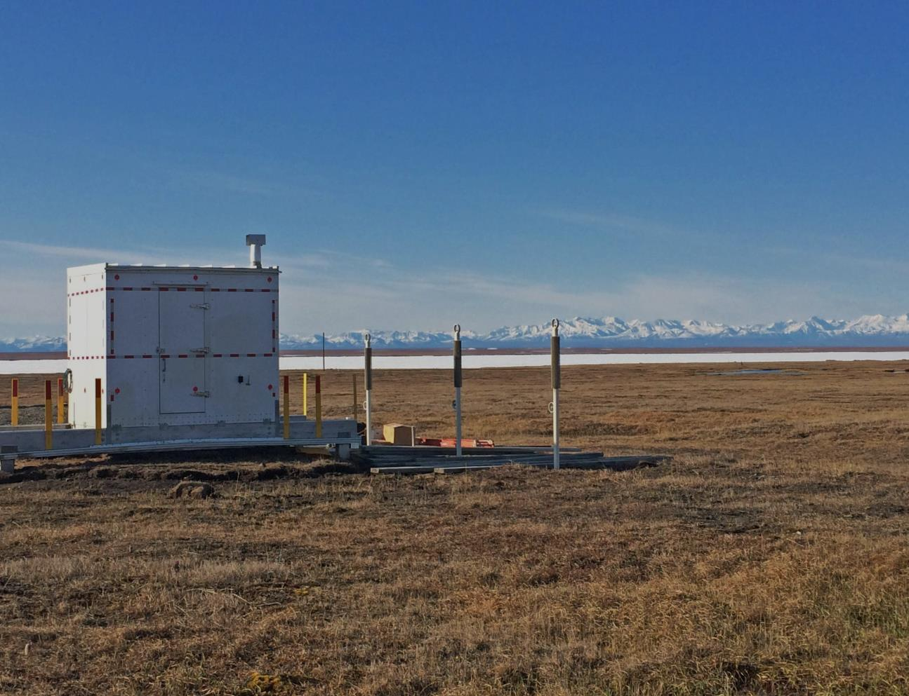
KAKTOVIK COMMUNITY FOUNDATION
Engineered Community Ice Cellar
Design & Construction
February 2017

Slide 2

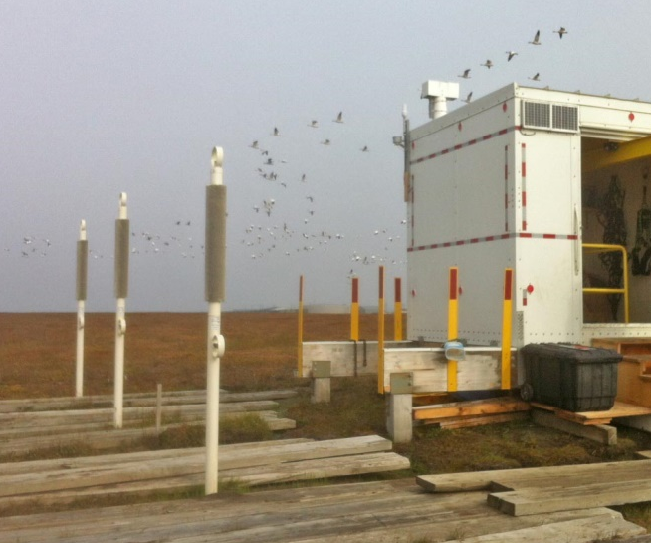
KAKTOVIK COMMUNITY FOUNDATION
Founded 2013
Tri-lateral Board of Directors (City of Kaktovik/Native Village of Kaktovik/Kaktovik Inupiat Corporation)
Mission – To celebrate Kaktovik Culture, Community and Learning
ICE CELLAR PRINCIPALS
Cellar storage to be shared each year between
Kaktovik’s 3 successful captains.
All cellar activity and operations to remain off-grid.
Cellar design represents a blend of Inupiaq tradition
and engineering technology.
Cellar design is intended to address climate change
through adaptation and monitoring.
All plans and learnings from the cellar design,
construction and operation to be shared with
whaling villages.

Slide 3
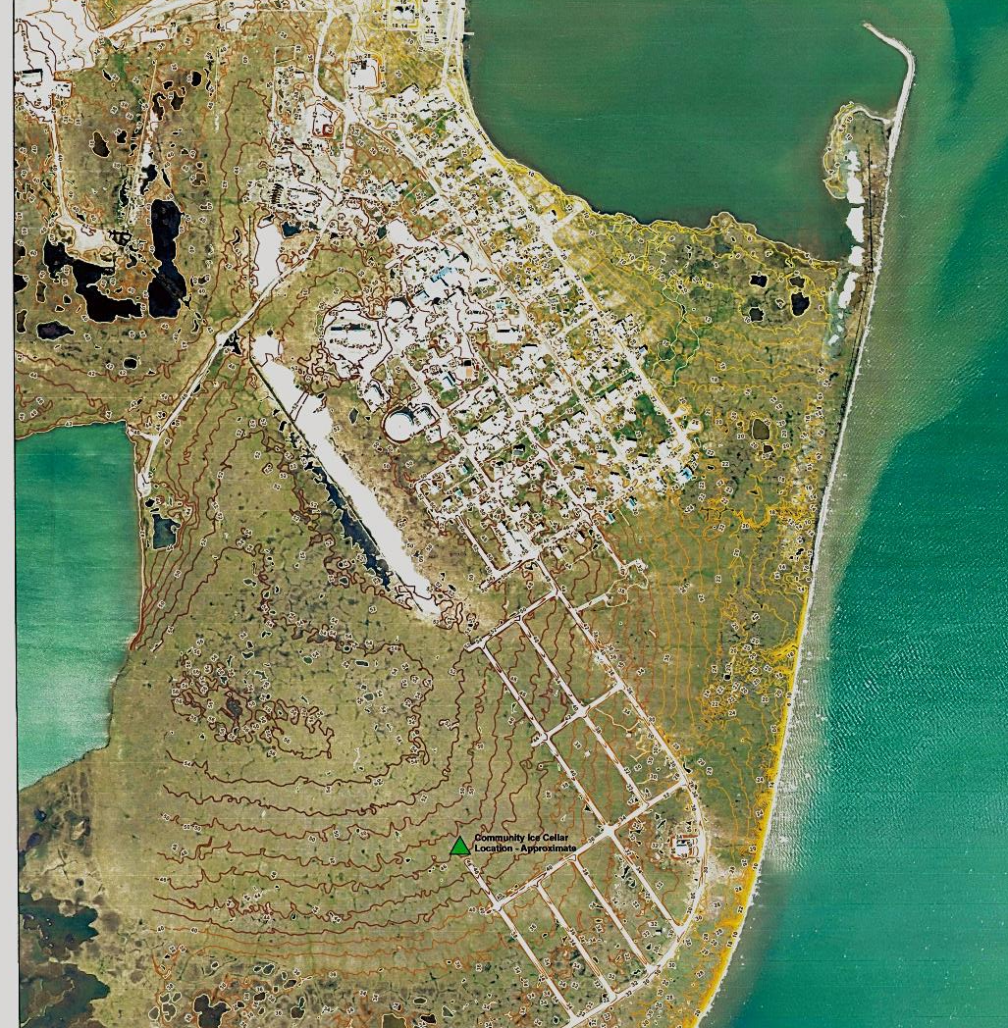
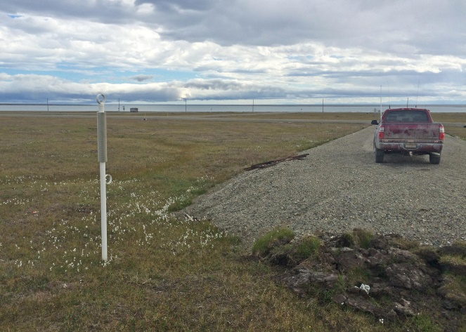
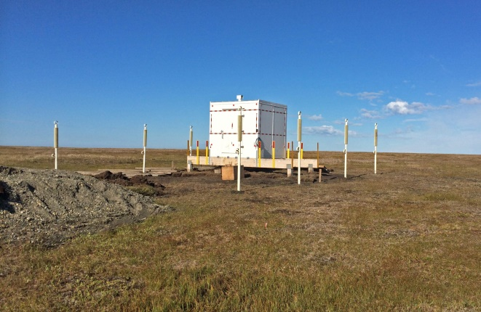
AERIAL PHOTO OF CELLAR LOCATION AND TOPOGRAPHY
Cellar view looking south
Cellar view looking north
Cellar located 48’ above sea level in a well-drained area
Latitude: 70.11838923909306 Longitude: 143.6145579814911

Slide 4
KAKTOVIK COMMUNITY ICE CELLAR
FOUR YEAR CONSTRUCTION SEQUENCE
The Kaktovik community ice cellar project was developed at a steady and methodical pace. Following completion of the 20-foot deep entry shaft in April 2015, further excavation was halted to allow inspection for possible water leakage during the spring/fall 2015 rains. The shaft remained dry so cavern work began in 2016.
2013 Phase I Project Planning and Design
Selection of quality building site
Permit review with NSB, State and Federal regulatory agencies
Fundraising for the project
Design consultation with whaling captains
Engineering of the cellar designed to meet the captain, climate change, safety and polar bear concerns
2014 Phase II Installation of the above-ground features
Placement of the yellow cedar spread foundation - posts 12-feet deep
Completion of the 6-foot deep 4’x4’ yellow cedar shaft cribbing
Construction and placement of the 8’x10’ insulated housing
Tundra packing around shaft
Installation of 8 thermosyphons on east and west side 12-feet deep
2015 Phase III Excavation of entry shaft
Excavation of the 4x4’ 20-foot deep cellar access shaft
Placement of high/low gutters to manage water run-off
Shaft rests for one year to observe water leakage if any
2016 Phase IV Excavation of meat storage cavern
Initiate excavation of the meat storage cavern with storage bench
Installation of temperature/humidity sensors; solar panels; satellite antennae

Slide 5
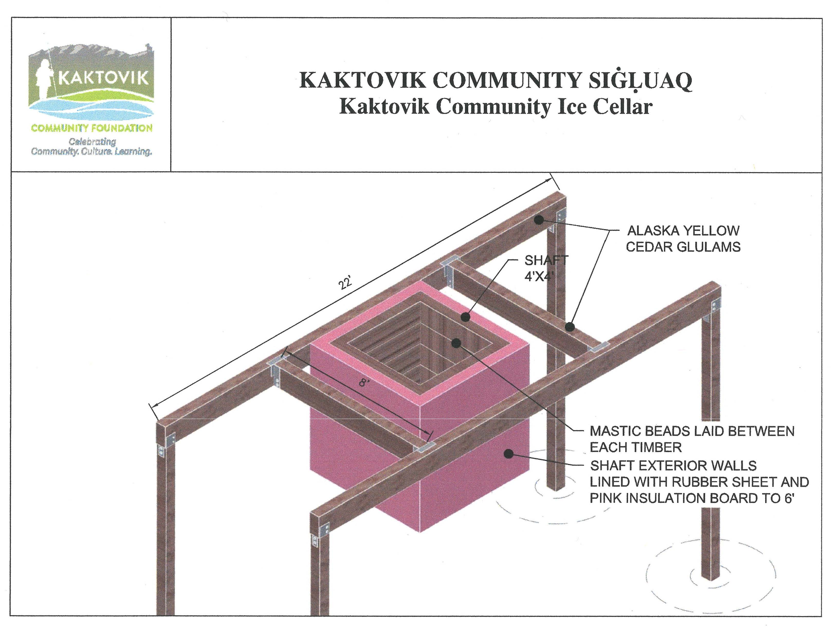

Slide 6
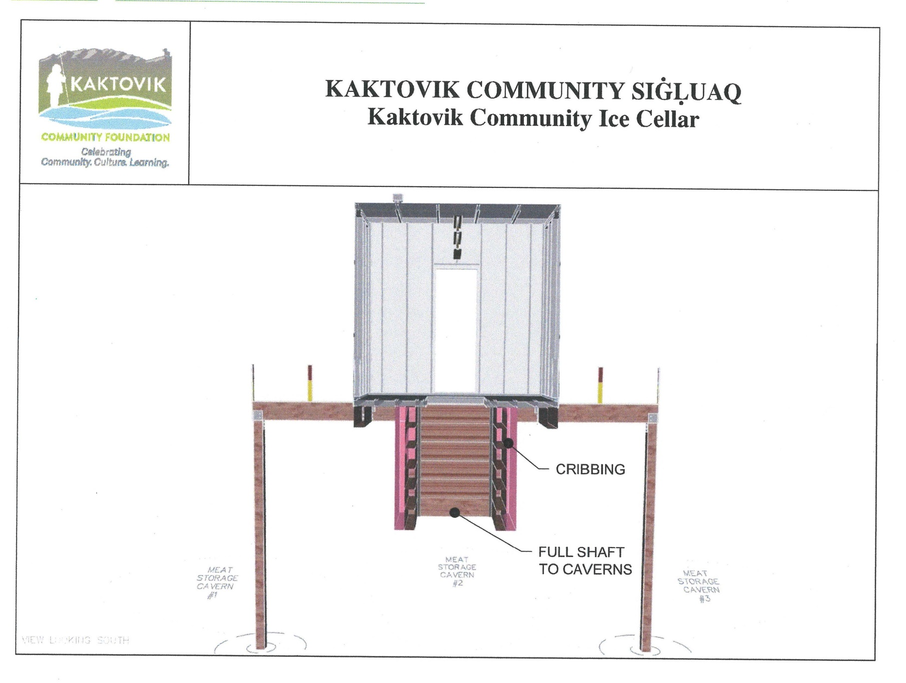

Slide 7
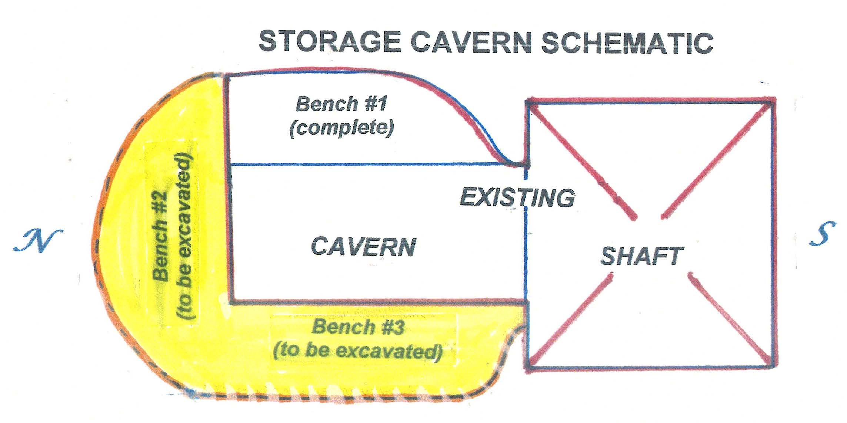
The meat storage cavern is being excavated to accept the community’s portion of the annual whale
harvest. The storage benches are carved into the permafrost and will keep the whale meat about 3 feet
off the floor.

Slide 8
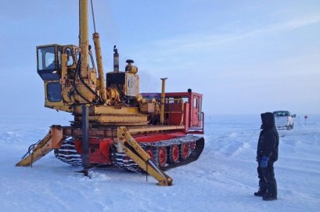
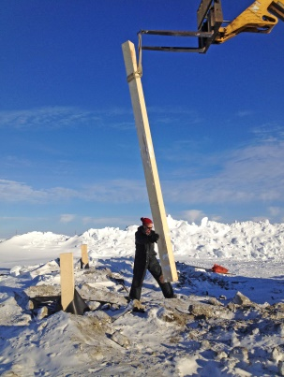
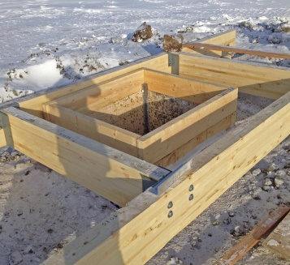
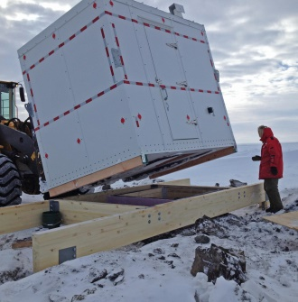
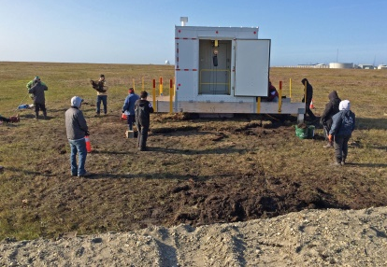
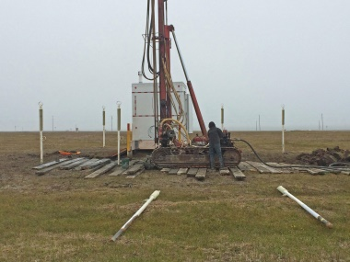
CELLAR CONSTRUCTION YEAR #1 – 2014
In February 2014, the NSB auger broke ground to drill post holes. 16-foot yellow cedar posts, buried 12-feet deep, form the corner supports for the spread housing foundation.
Yellow cedar housing foundation and cribbing. Six foot deep cribbing wrapped with rubber sheeting and lined with pink insulation; metal braces reinforce the corners; water proof mastic applied between cribbing timbers.
8x10 housing assembled in the NSB Kaktovik garage, delivered to the site by NSB Public Works.
Community volunteers cut tundra blocks from Barter Island sea cliffs, then NSB Public Works transported them to the cellar. Volunteers packed the tundra around the shaft.
Eight 22’ long thermosyphons were buried 12’ on the east/west side of the housing; at the same time a thermistor string was buried 12’ deep on the east/west side.

Slide 9
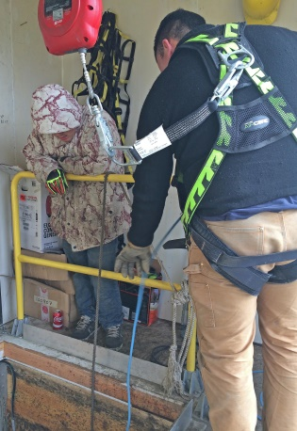
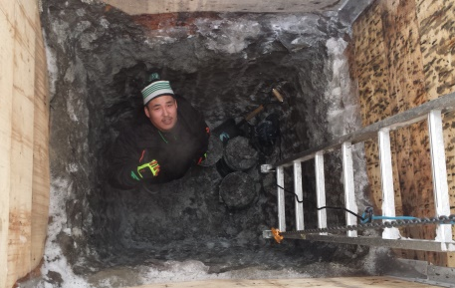
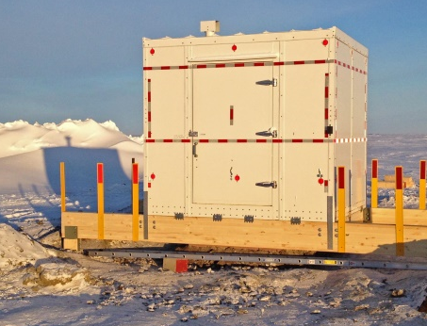
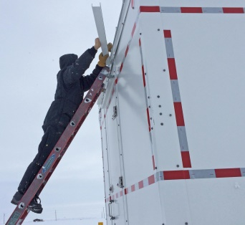
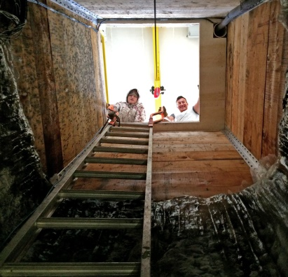
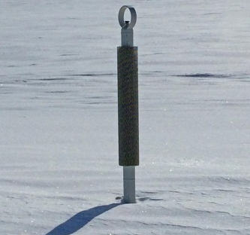
CELLAR CONSTRUCTION YEAR #2 – 2015
Safety was the prime design and construction objective. A removable safety rail surrounds the shaft, as do toe stops. A heavily insulated and reinforced hatch door covers the shaft which remains closed when the cellar is not in use.
A self-arrest safety vest must be worn by anyone entering the shaft. No one can enter the shaft without an observer on the surface and no one under the age of 18 can enter the cellar. Multiple reflectors on the exterior of the housing help ensure snow machines avoid the cellar structure in a white out.
The 4’x5’ shaft was excavated to about 20’ deep with jack hammers; John Henry Akpik joined a foundation volunteer to complete the work. The shaft permafrost consisted of uniform fines; no clay, ice lenses, subsurface water or gravel was encountered.
Gutters were installed on the north side of the housing above and below the rear door to direct roof runoff away from the shaft. Work was suspended for 1 year to observe any water intrusion before starting the storage cavern.

Slide 10
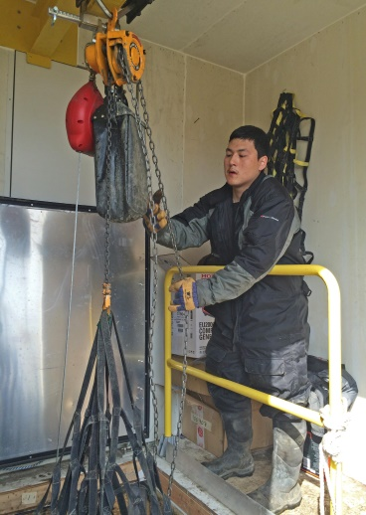
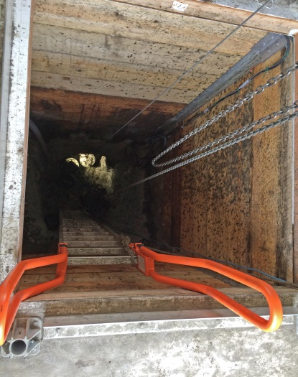
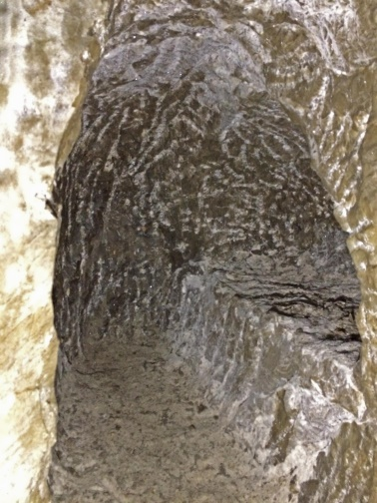
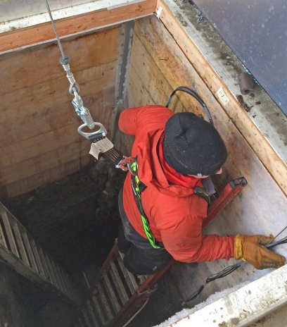
CELLAR CONSTRUCTION YEAR #3 – 2016
The cellar was confirmed dry after observing for a year, permitting excavation of the meat storage cavern off the back of the shaft. A team of Levi Rexford (Kaktovik) and Jesstin Peterson (Barrow) created the first portion of the arched shaped cavern. It currently measures 10’ long, 7’ high and 4’wide.
The cavern is entered via a step-up from the shaft floor in case water enters the shaft. In addition, to protect the stored whale harvest, a large permafrost bench, the first of three, was created along the side of the cavern to store the meat off the cavern floor.
Data sensors were installed in the cavern, the shaft, the housing and outside the cellar to record air and soil temperatures at the site. In addition, a secondary fresh air line was installed into the shaft. An ice plug was removed from the primary fresh air line, corrected by extending the roof vent with longer rain shields. Two solar panels were installed on the south exterior wall and the satellite antenna on the roof.
As a final task, a mix of three types of arctic grass seed was thrown around the cellar to help enhance revegetation at the site.

Slide 11
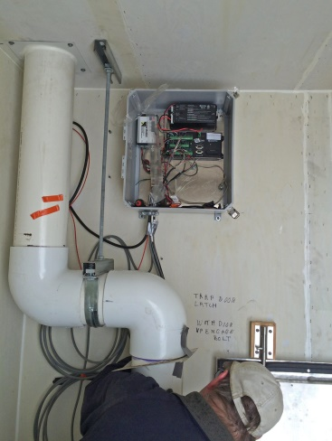
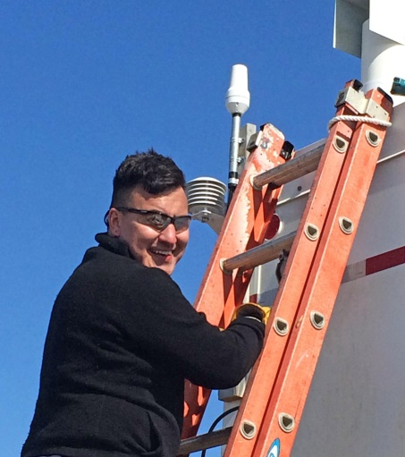
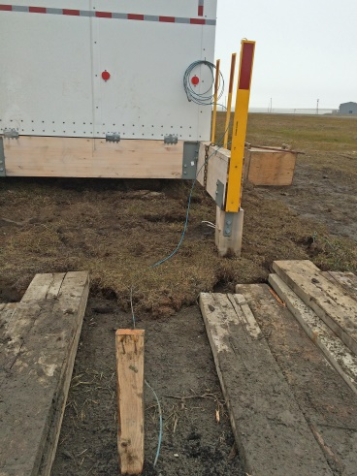
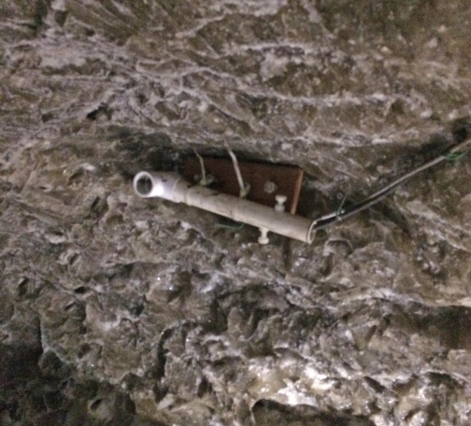
TECHNICAL MONITORING OF CELLAR SITE
Sensor data collected in control box which also includes the batteries.
Data transmitted to satellite via roof antenna.
Future plans to transmit data to University of Alaska-Fairbanks for QA/QC and to the Harold Kaveolook School for Kaktovik student science classes.
Control Box
Satellite Antenna
Environmental sensors:
Outdoor air temperature
Inside housing air temperature
Soil temperatures on east/west side of the cellar (3’ intervals to 12’)
Cavern cellar temperature and humidity
Battery voltage tracking via solar panels
Temperature sensor on ceiling of storage cavern
Thermistor Cord

Slide 16
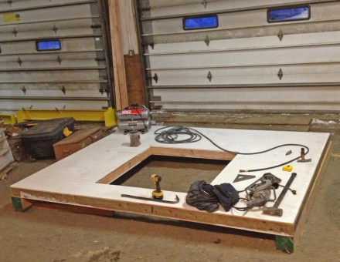
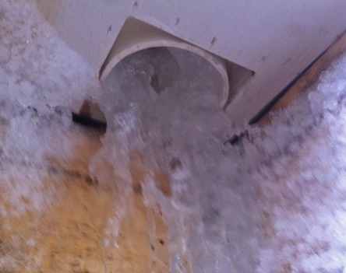
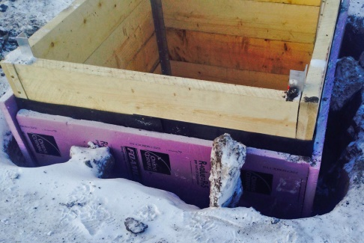
LESSONS FROM KAKTOVIK CELLAR DESIGN & CONSTRUCTION
The design placed the cellar shaft wall too close to the back wall of the housing. The roof slopes slightly to the back which created issues with roof run-off.
Orientation of cellar housing with regard to prevailing winds important to avoid drifting issues. Kaktovik’s prevailing winds are from the west and east so entrance door was located to the south and has kept clear.
This project was approached as community infrastructure not as a captain’s family cellar; therefore community volunteers assigned to heavy and difficult work were paid.
Water is the enemy. Heavy rains penetrated the ends of the vent cap, which needed to be extended. Waterproofing and insulating the cribbing is required.
Highly recommend storage caverns keep the whale meat off the floor; helps protect from possible water leaks and makes cellar cleaning much easier.
Spread foundation highly recommended which allows uninhibited below ground excavation.

Slide 17
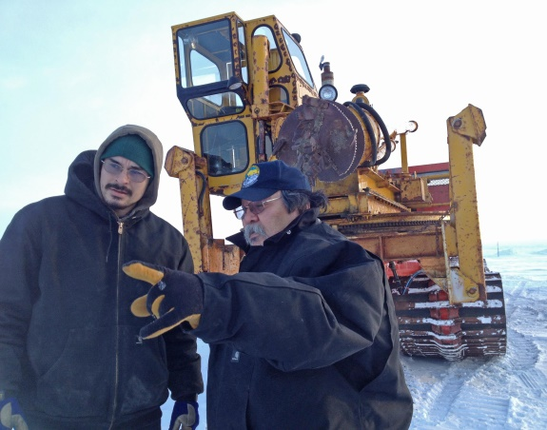
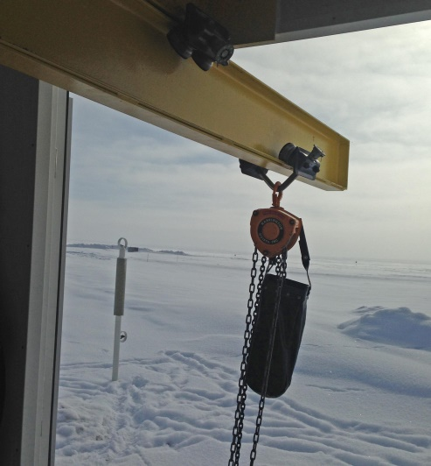
LESSONS (Continued)
Must have NSB Public Works personnel and equipment support construction and mobilization.
Protect tundra from foot and equipment traffic and from all excavated material. Tundra is the guardian against water and thawing soils.
Must have access to prime site on NSB or corporation land that is well elevated and is away from snow fences/gravel roads/future structures.
Rolling beam that extends out the cellar door facilitates loading in the cargo net, then it is rolled back inside over the shaft to be lowered down to the storage cavern.
Self-arrest hoist on the rolling beam makes heavy lifting in and out of the shaft very easy.
A community cellar is not customary on Alaska’s North Slope, like it is in Canada. This concept must be acceptable to the community.

Slide 18
ICE CELLAR KEY CONTRIBUTORS
In-kind Support Financial Support
North Slope Borough Arctic Slope Community Foundation
Kaktovik Inupiat Corporation ExxonMobil
Kaktovik Community Volunteers Shell
Plus many more companies, contractors and individuals
Cellar Design Advisors
Kaktovik Whaling Captains Association
Key Cellar Construction Contractors
Housing and Foundation Design & Construction: Alchem, Inc.
Thermosyphon Fabrication: Arctic Foundations, Inc
Data Monitoring Design and Installation: Dryden Instrumentation

Slide 19
KAKTOVIK COMMUNITY FOUNDATION
Board of Directors
2017 Board
President Matthew Rexford Native Village of Kaktovik
Vice President Charles C. Lampe Kaktovik Inupiat Corporation
Secretary Nora Jane Burns City of Kaktovik
Treasurer Ida Angasan City of Kaktovik
Member Edward Rexford Native Village of Kaktovik
Member George Kaleak At-Large
Member Annie Tikluk At-Large
2017 Staff
Executive Director Marnie Isaacs
Attorney Walter Featherly, Holland & Knight
Accountant Key Getty, BDO

Slide 20
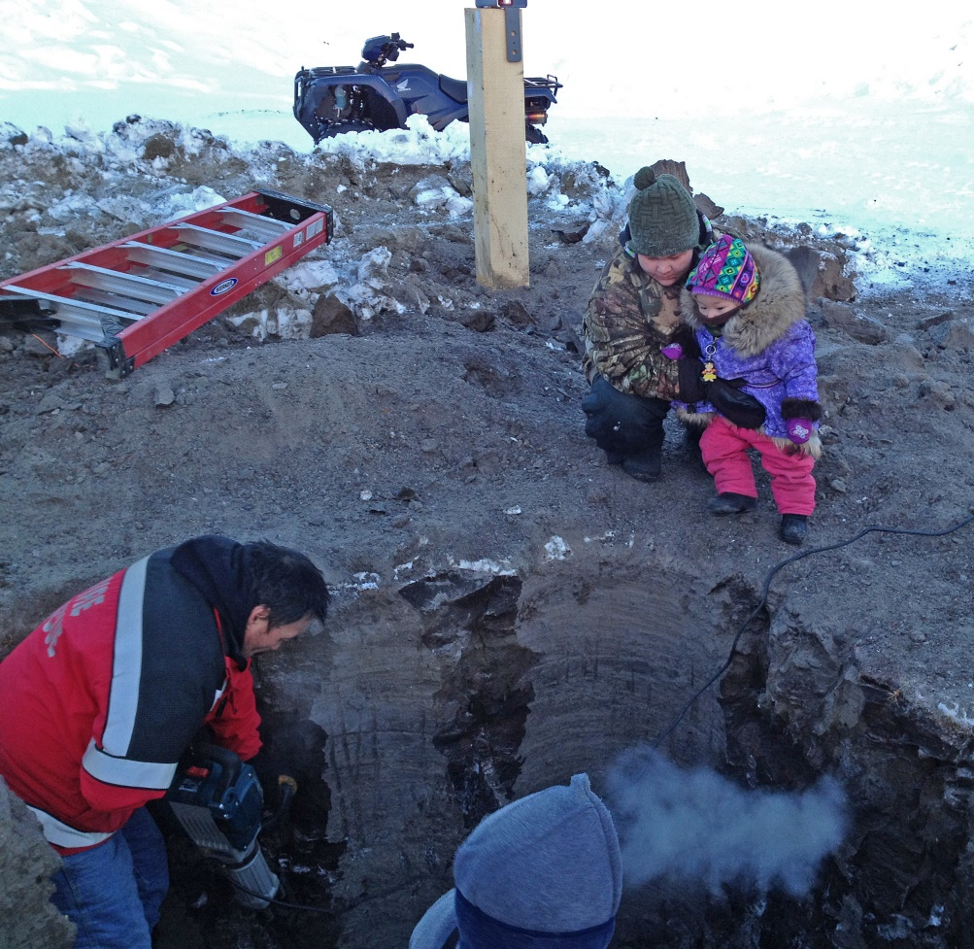
QUYANAQPAK

