Slide 1


LEO Alaska Webinar
Spring 2025 Climate Review
Summer 2025 Climate Outlook
Rick Thoman
Alaska and Arctic Climate Specialist
rthoman@alaska.edu
June 10, 2024

Slide 2
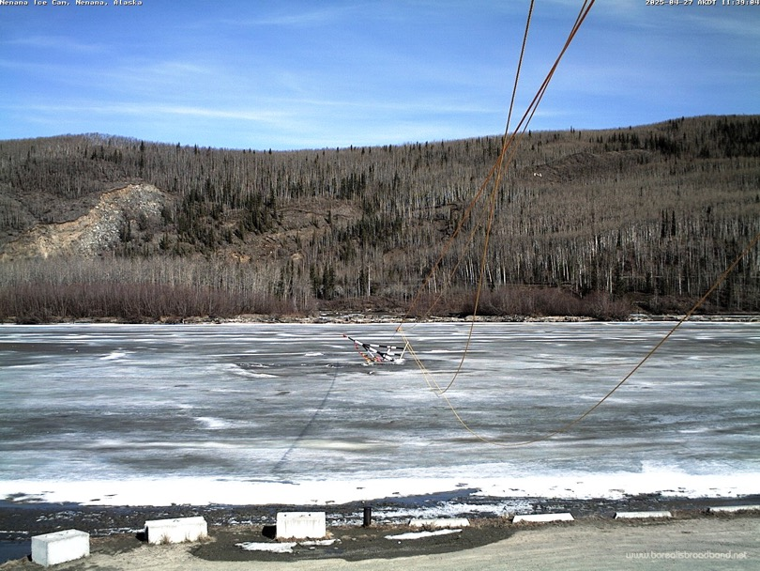

Alaska Highlights
Excessive rain Southeast April and May
  Flooding and landslides
Mostly uneventful river break-up
  Dramatic change from past few years
Anchorage snowiest Spring since 2013
Cool (and some areas cloudy) May
  Slow start to gardening season
Sea ice decrease in the Bering Sea after mid-April but slow in Chukchi Sea
Tripod on the Tanana River
April 27, 2025
Photo courtesy Nenana Ice Classic

Slide 3
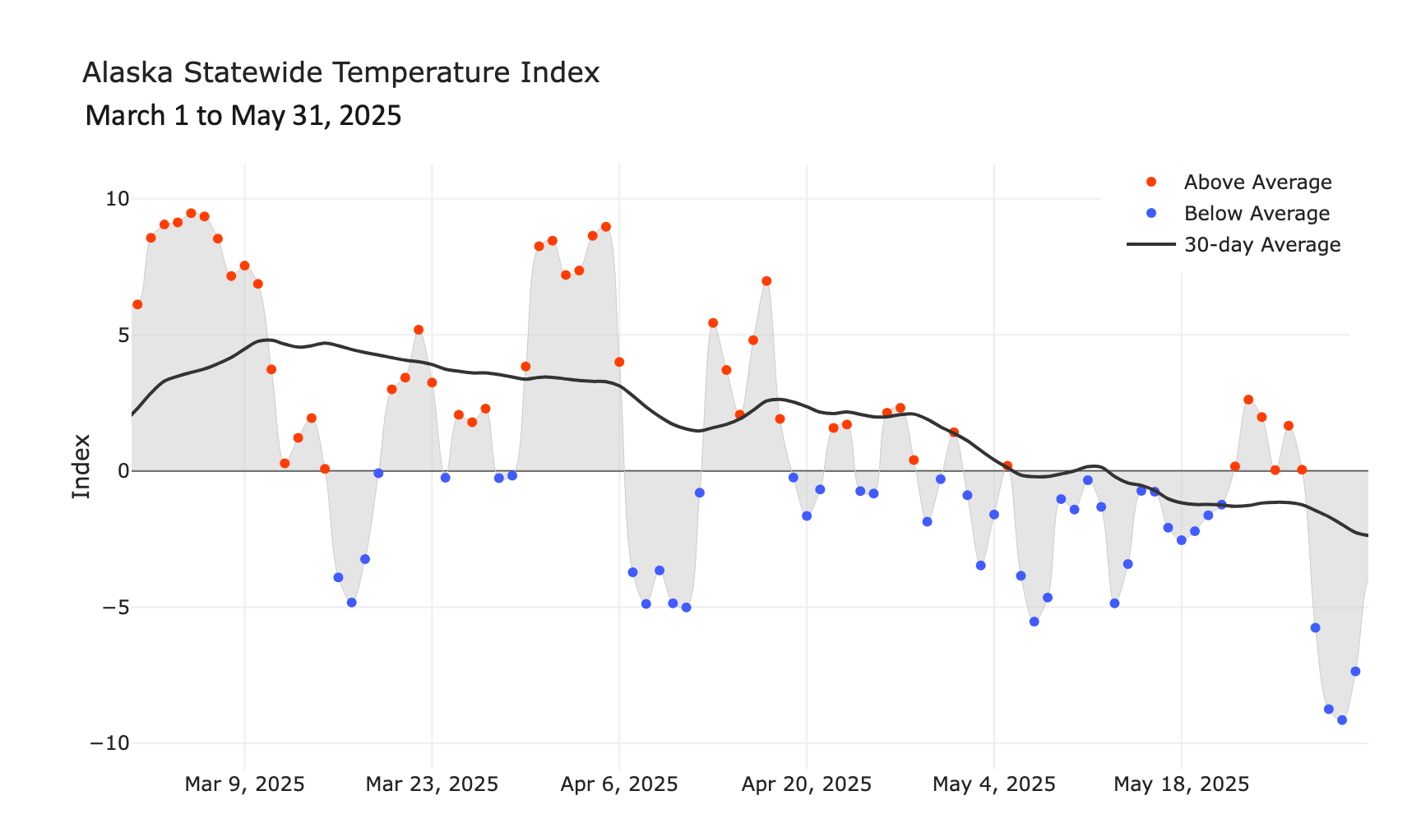
Alaska Daily Temperature Index

Slide 4
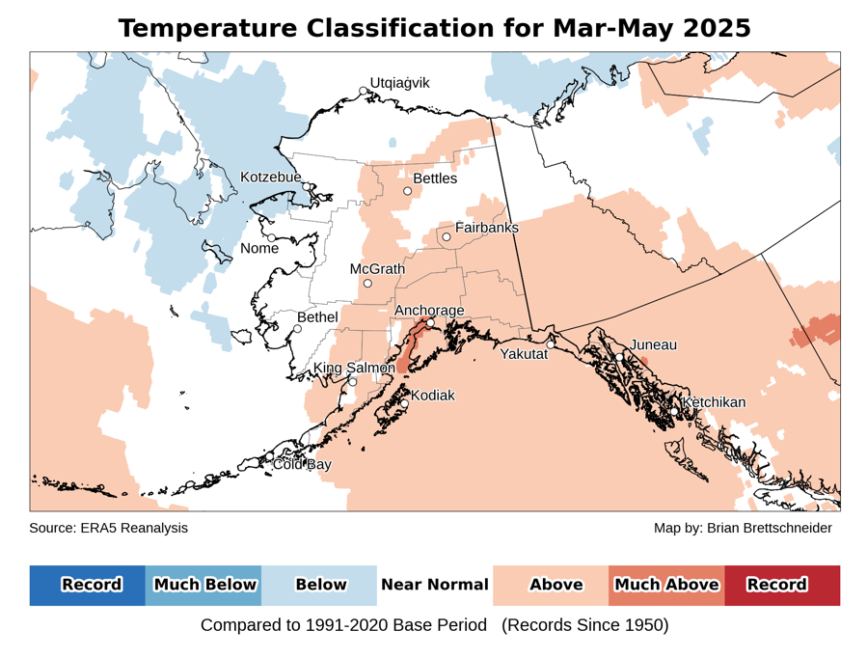
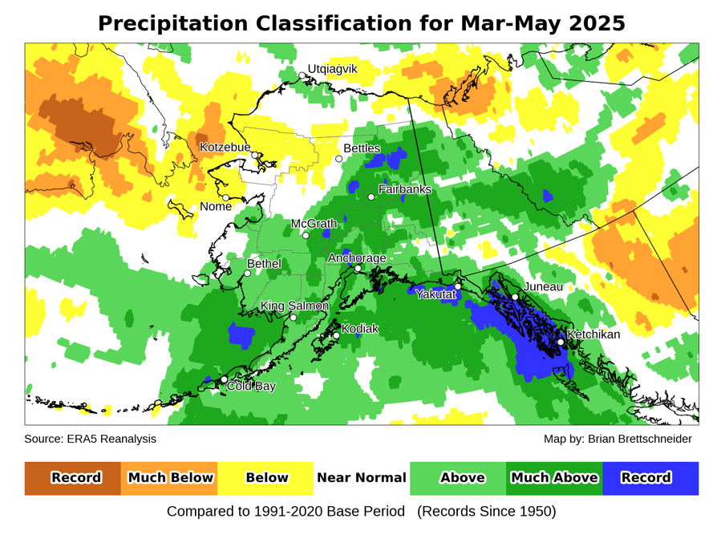
Spring 2025
Temperature and precipitation
Data: ERA5 courtesy of EMCWF/Copernicus
1991-2020 Baseline
Notes:
AK Summer: 45% of Alaska land area temp above normal, first summer since 2014 with less than half of the state warmer than normal
YT Summer: 4th summer in a row 100% above normal
NWT Summer: 99% above normal but lowest since 2021
AK Summer: 83% of Alaska land area above normal precipitation. Highest since 1998

Slide 5
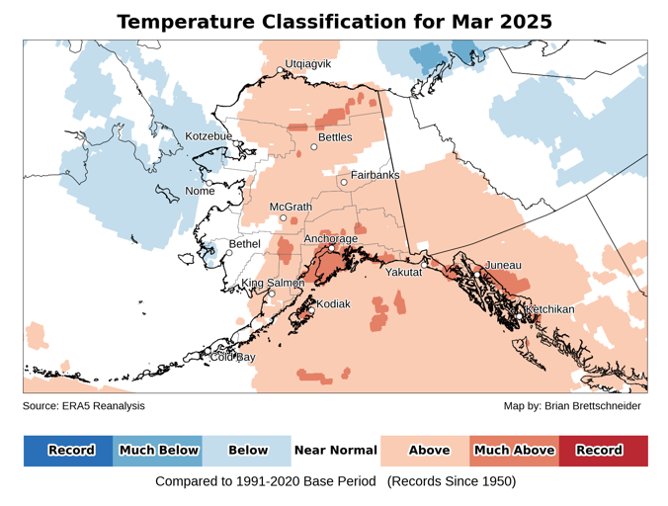
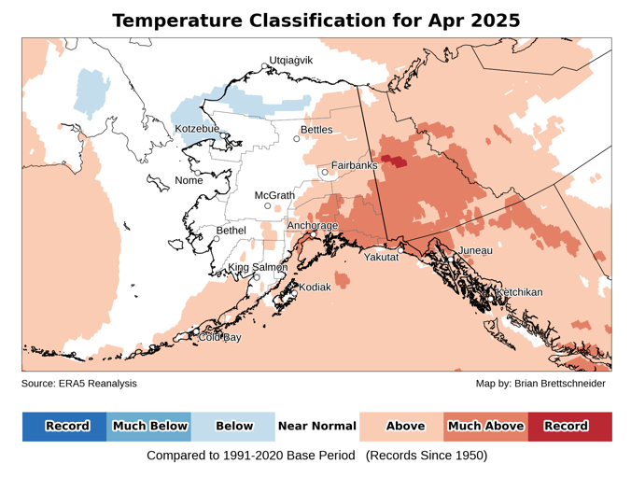
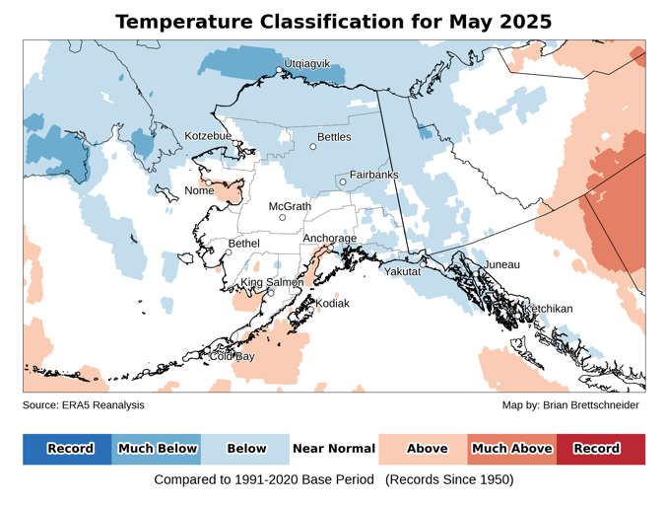
Monthly temperatures
Data: ERA5 courtesy of EMCWF/Copernicus
1991-2020 Baseline
Notes:
AK Summer: 45% of Alaska land area temp above normal, first summer since 2014 with less than half of the state warmer than normal
YT Summer: 4th summer in a row 100% above normal
NWT Summer: 99% above normal but lowest since 2021
AK Summer: 83% of Alaska land area above normal precipitation. Highest since 1998

Slide 6
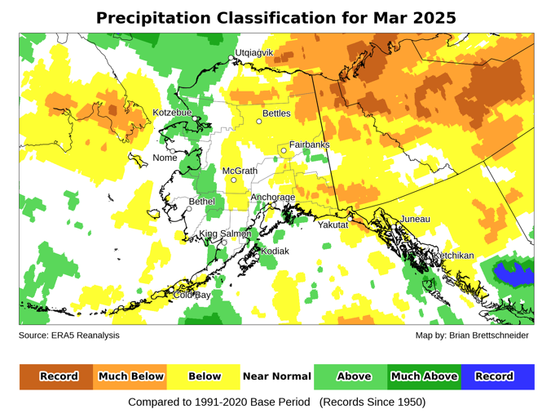
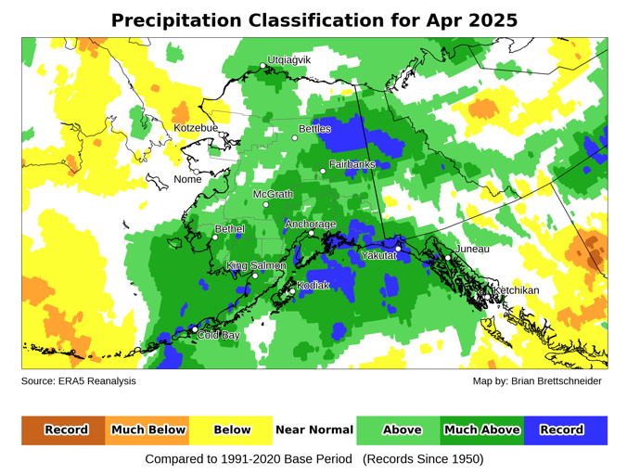
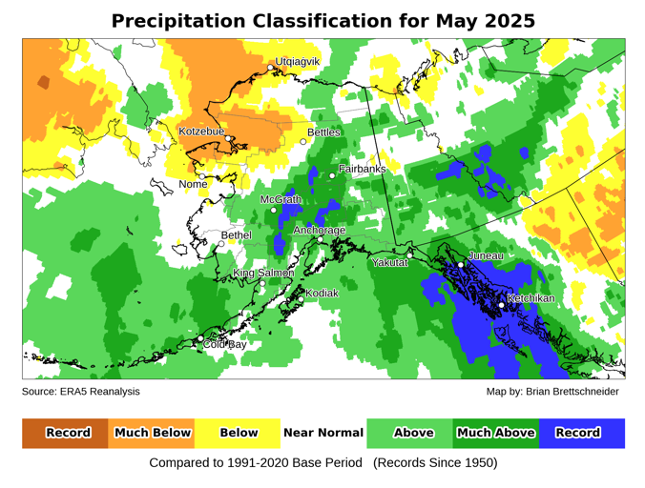
Monthly precipitation
Data: ERA5 courtesy of EMCWF/Copernicus
1991-2020 Baseline
Notes:
AK Summer: 45% of Alaska land area temp above normal, first summer since 2014 with less than half of the state warmer than normal
YT Summer: 4th summer in a row 100% above normal
NWT Summer: 99% above normal but lowest since 2021
AK Summer: 83% of Alaska land area above normal precipitation. Highest since 1998

Slide 7
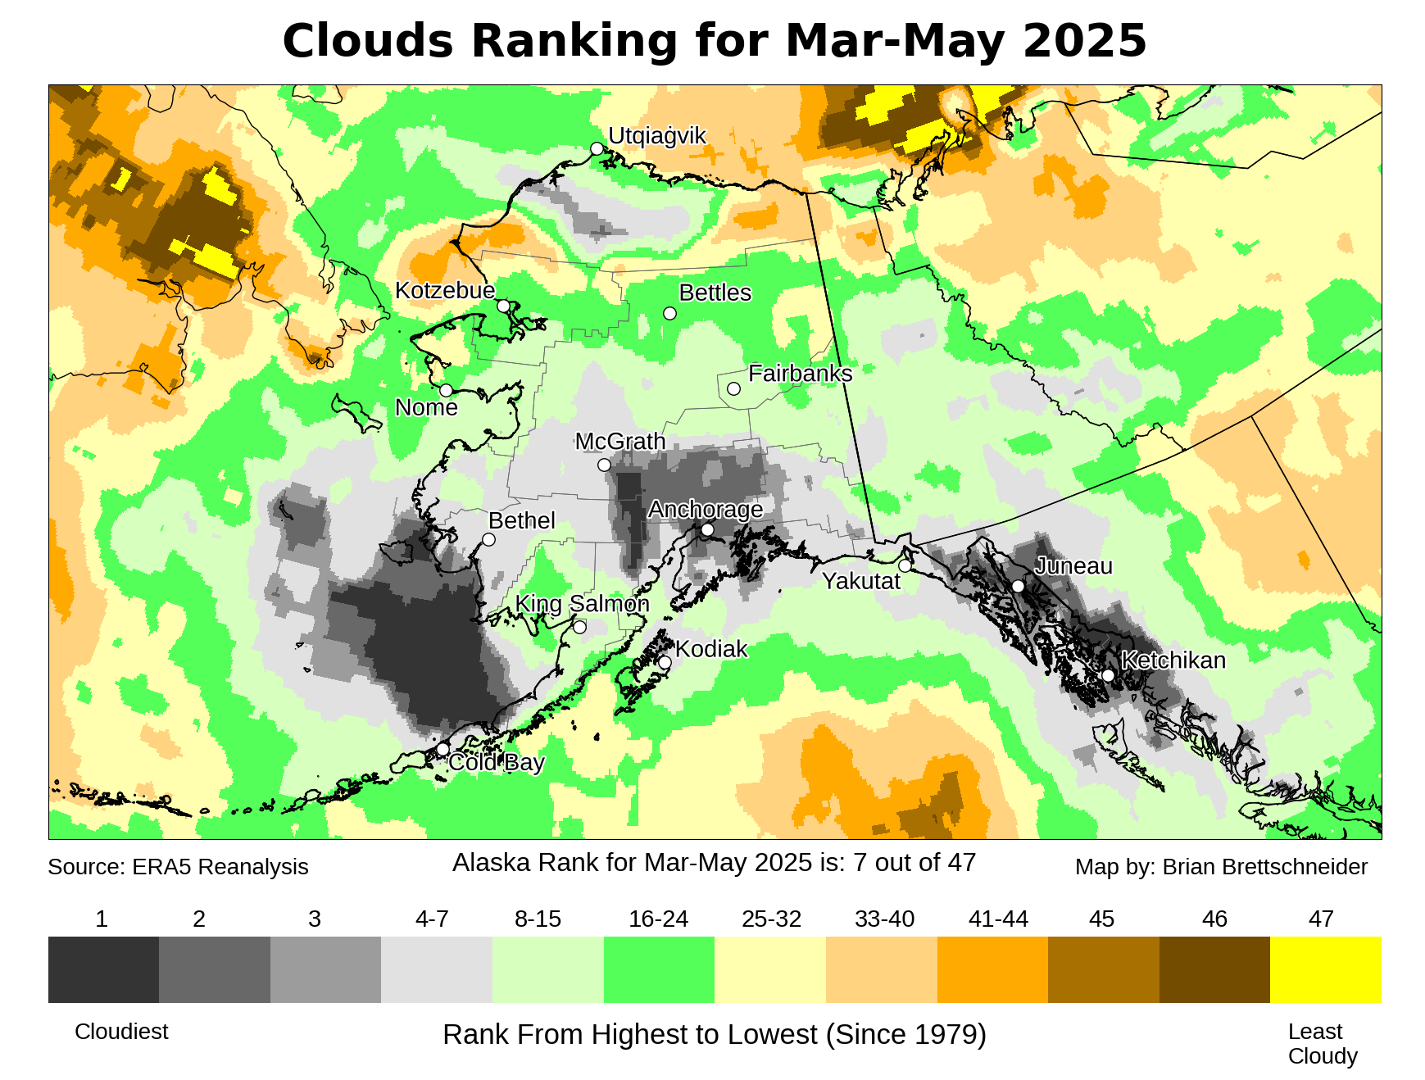
Spring 2025 cloudiness

Slide 8
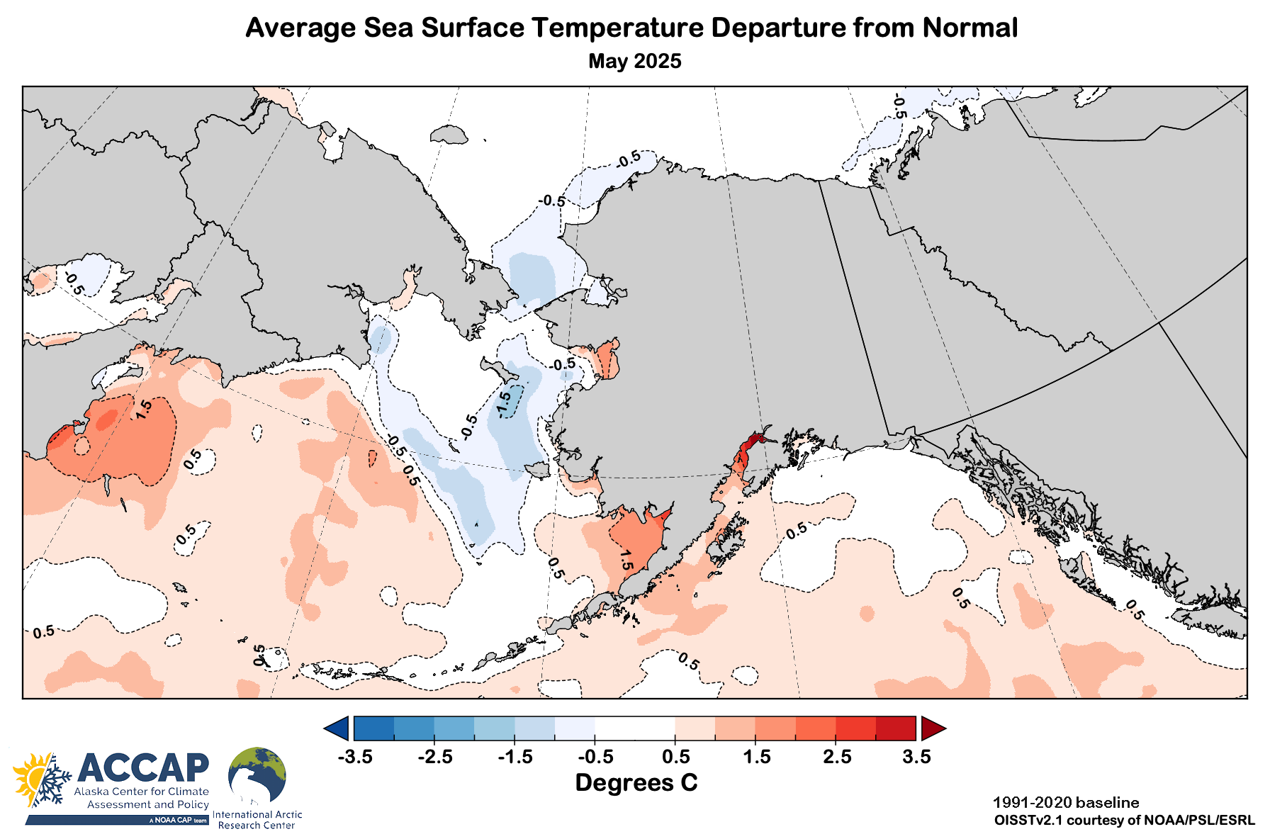
May 2025 sea surface temperatures

Slide 9
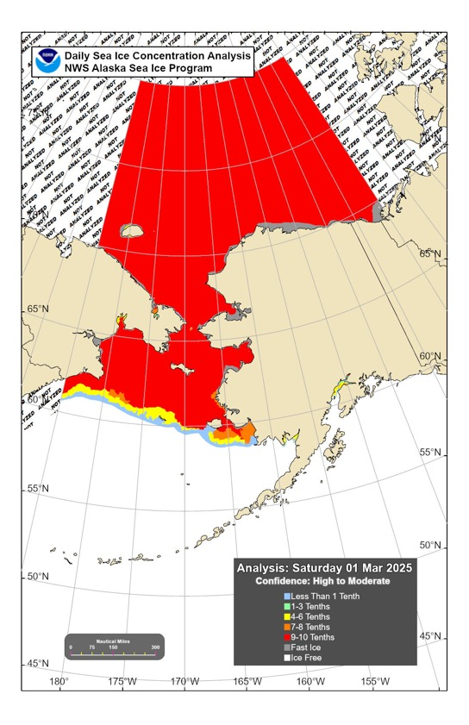
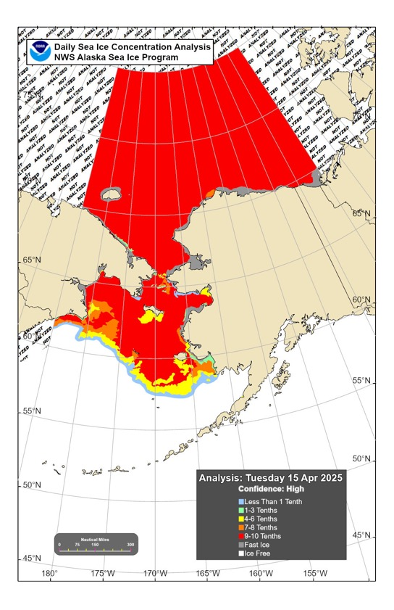
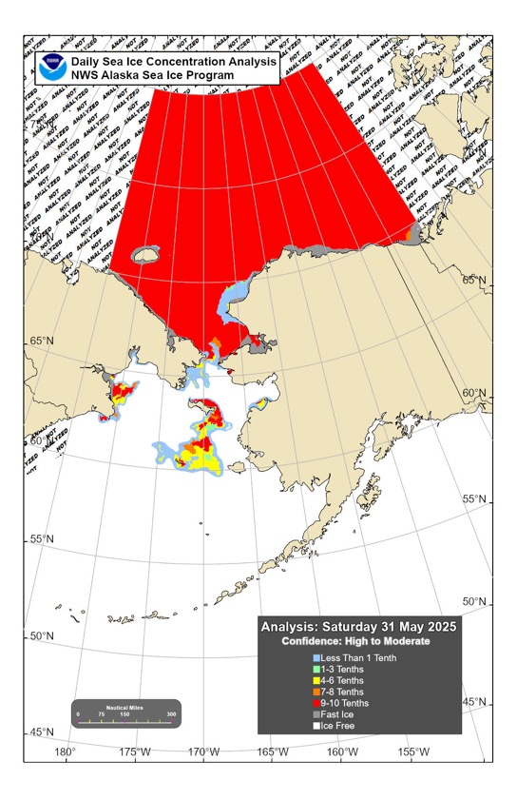
Sea ice extent: Spring 2025
March 1
April 15
May 31

Slide 10
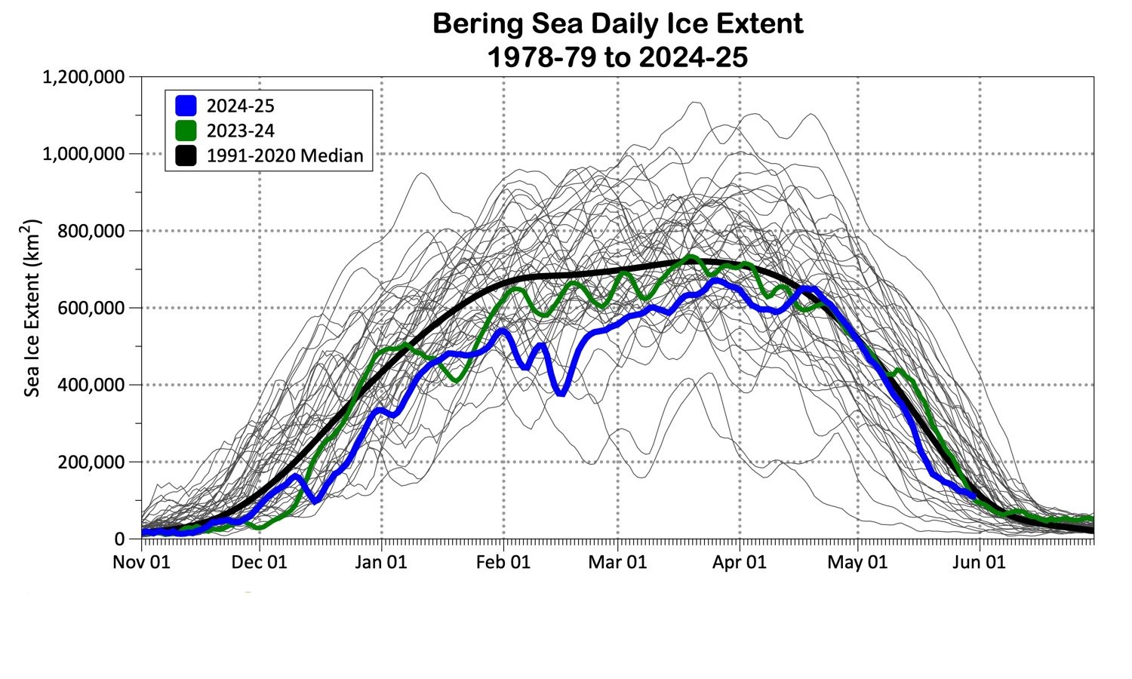
Bering Sea ice extent

Slide 11
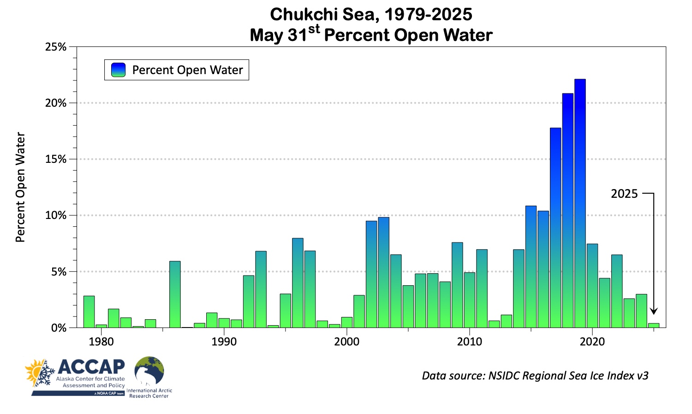
Slow start to Chukchi Sea ice melt
2024

Slide 12


Summer 2025 Outlooks
Arctic Sea Ice Experimental Outlook
Spring Sea surface temperatures
Spring temperature and precipitation

Slide 13
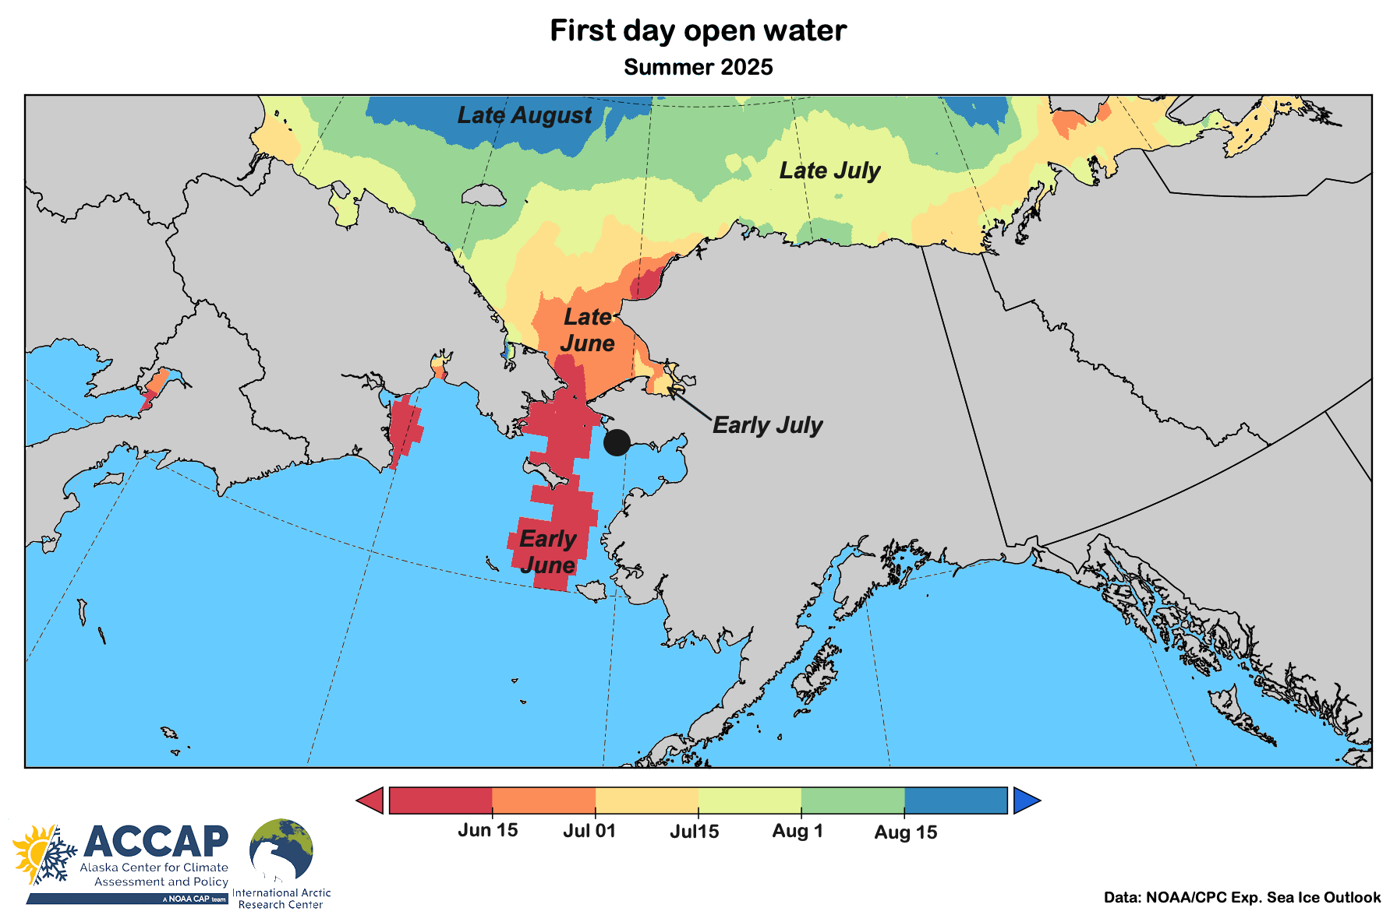
Sea ice outlook: Spring/Summer 2025
Data: NOAA/Climate Prediction Center Exp. Sea Ice Outlook
Outlook produced from late May 2025 data

Slide 14
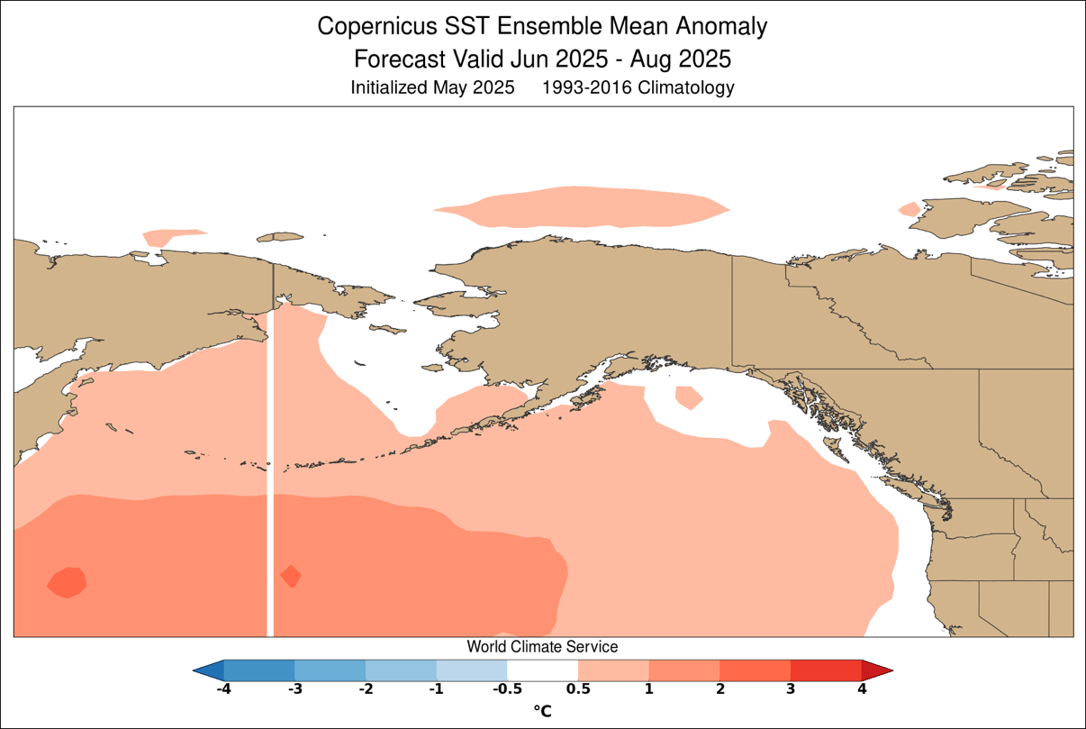
Sea surface temperature: Summer 2025
Graphic courtesy World Climate Service

Slide 15
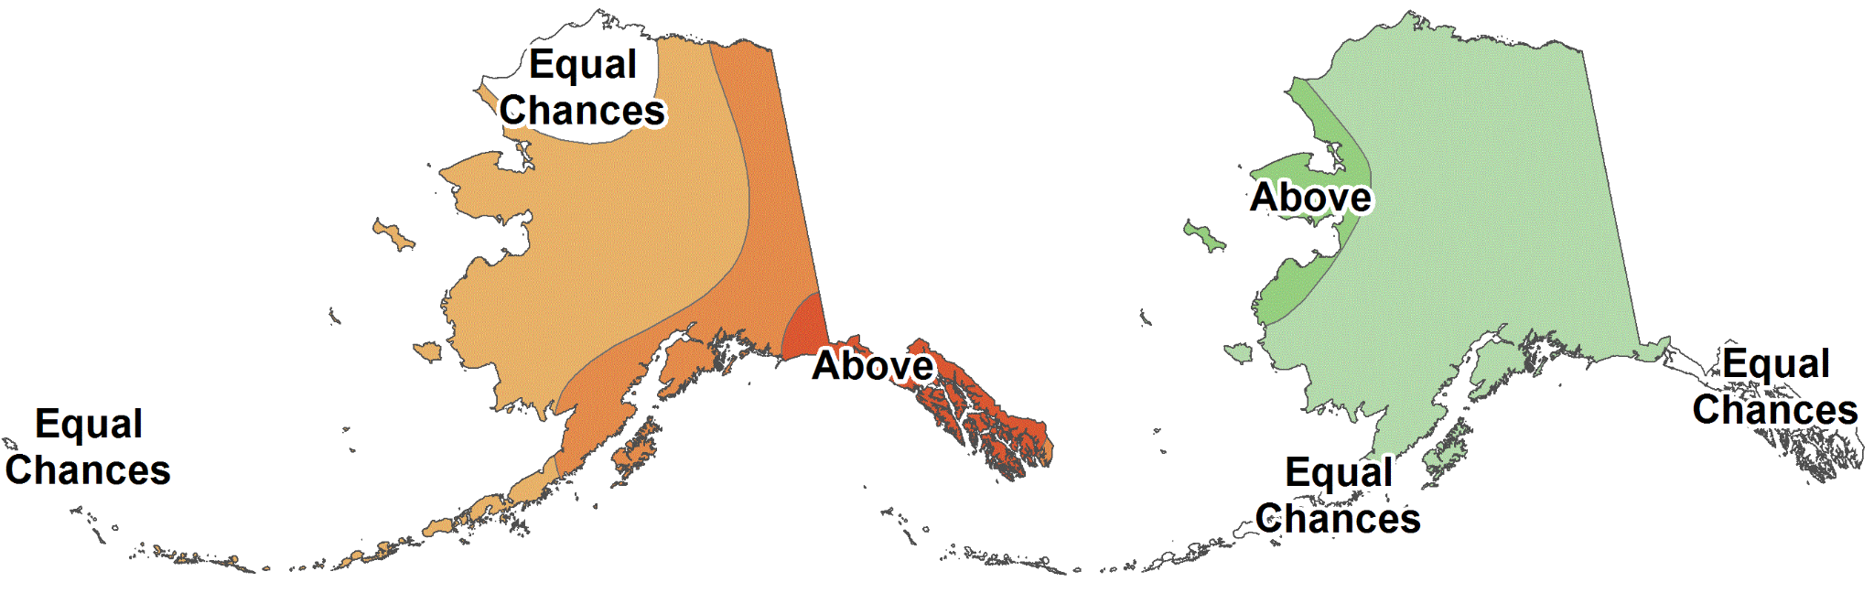
Summer 2025
NOAA Climate Prediction Center outlooks
Average Temperature
Total Precipitation
June through August 2025
Outlook made in mid-May

Slide 16
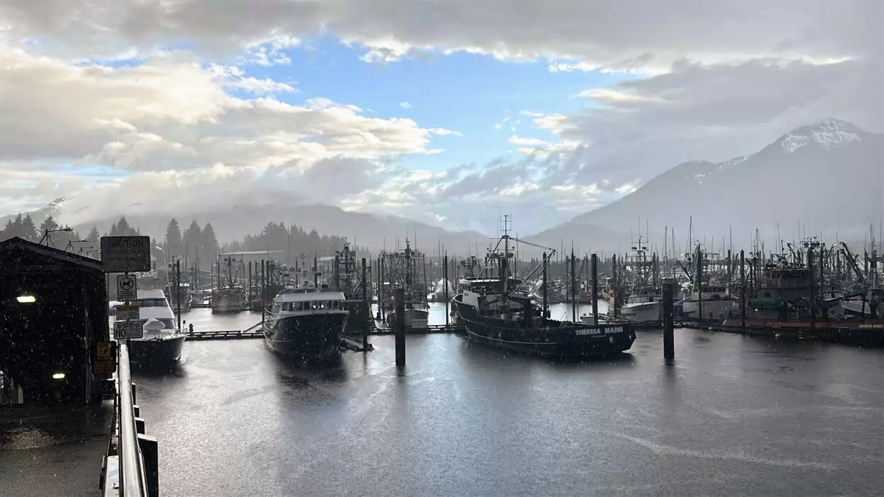

Thanks very much
Questions?
Photo: O. Rose/KFSK Petersburg

