Slide 1
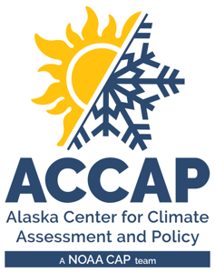

LEO Alaska Webinar
Winter 2024-25 Climate Review
Spring 2025 Climate Outlook
Rick Thoman
Alaska and Arctic Climate Specialist
rthoman@alaska.edu
March 11, 2024

Slide 2
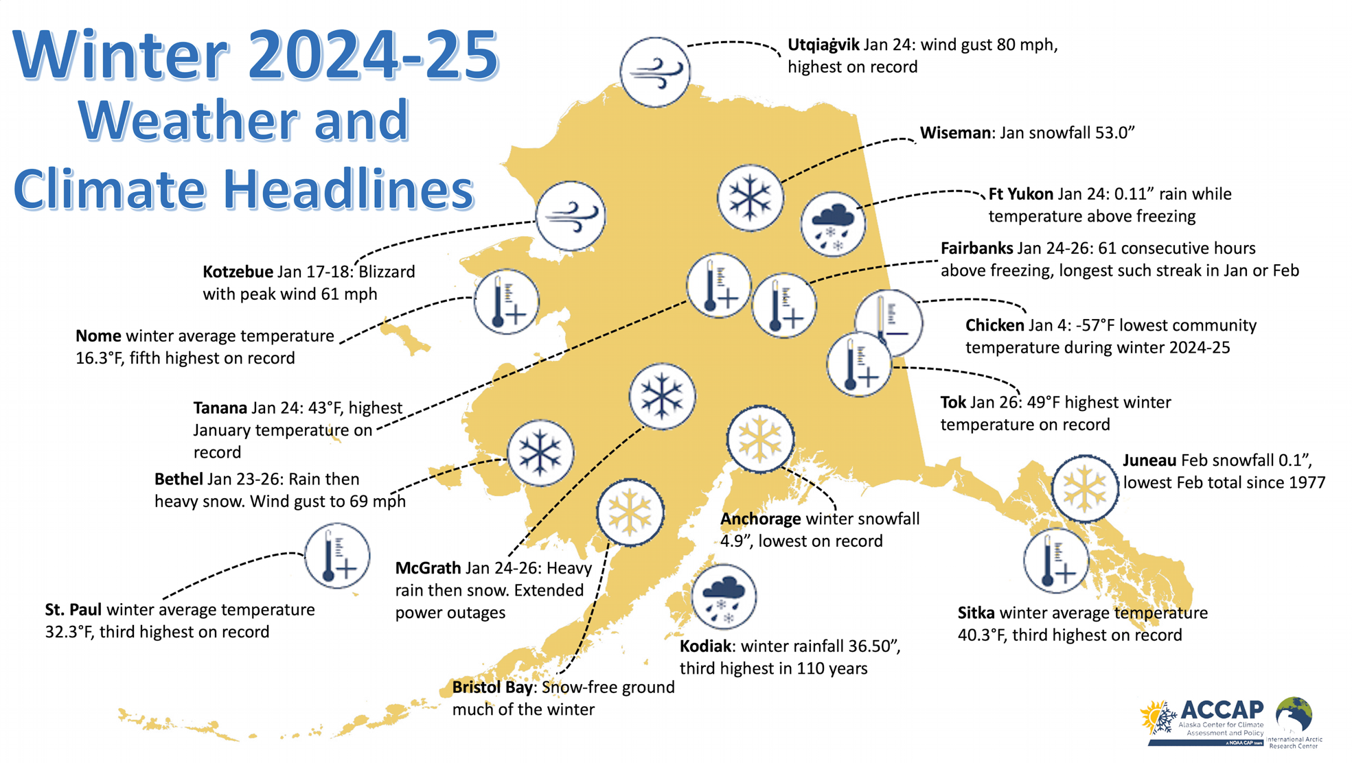

Slide 3
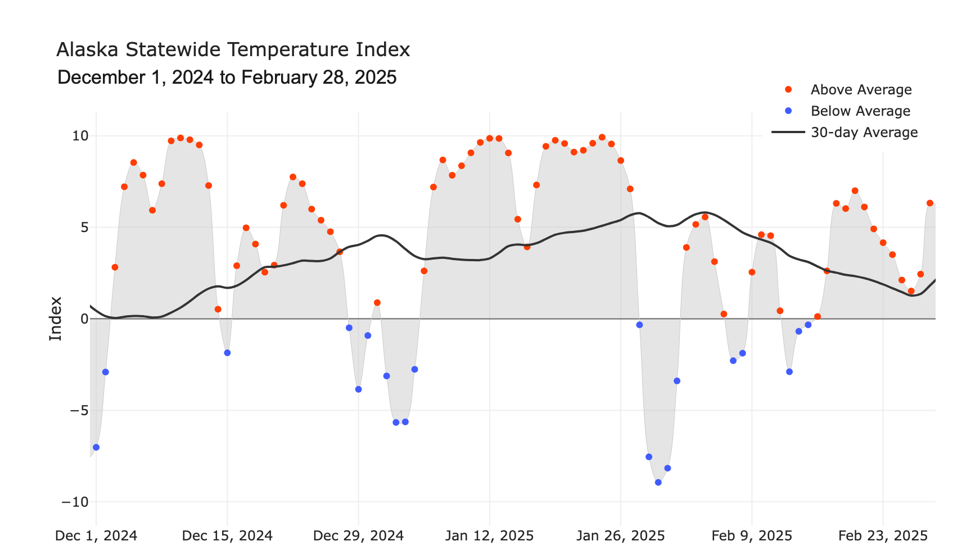

Alaska Daily Temperature Index

Slide 4
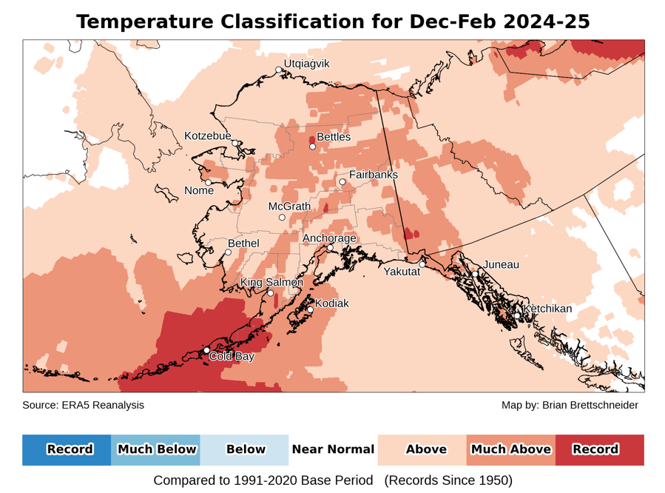
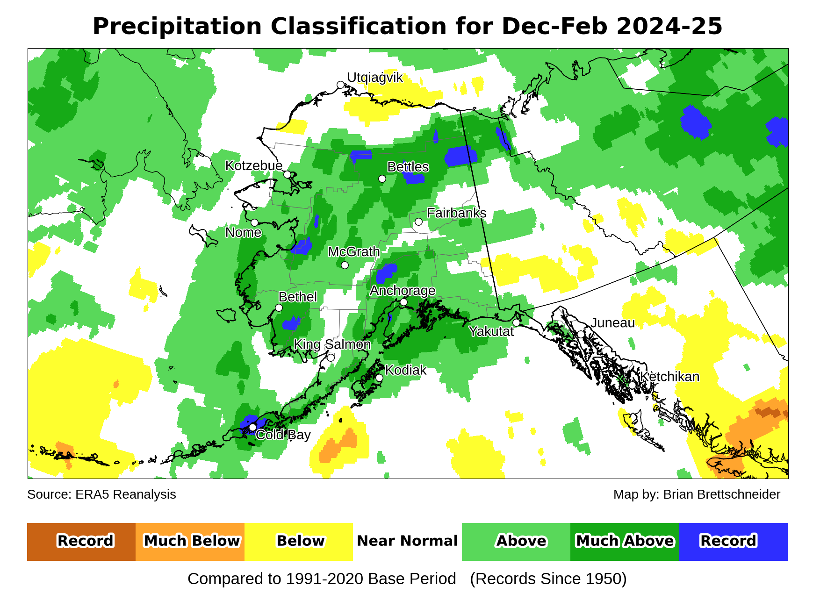
Winter 2024-25
Temperature and precipitation
Data: ERA5 courtesy of EMCWF/Copernicus
1991-2020 Baseline
Notes:
AK Summer: 45% of Alaska land area temp above normal, first summer since 2014 with less than half of the state warmer than normal
YT Summer: 4th summer in a row 100% above normal
NWT Summer: 99% above normal but lowest since 2021
AK Summer: 83% of Alaska land area above normal precipitation. Highest since 1998

Slide 5
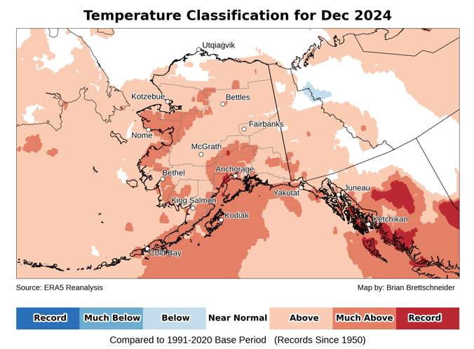
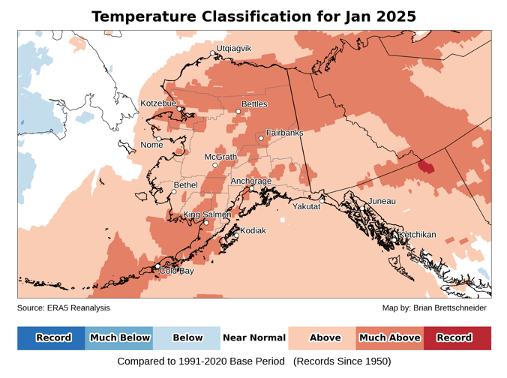
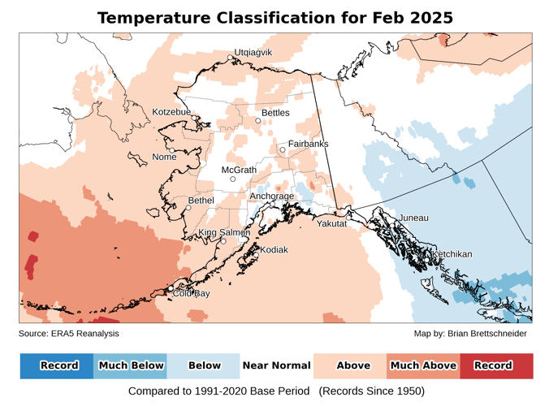
Winter 2024-25 temperatures
Data: ERA5 courtesy of EMCWF/Copernicus
1991-2020 Baseline
Notes:
AK Summer: 45% of Alaska land area temp above normal, first summer since 2014 with less than half of the state warmer than normal
YT Summer: 4th summer in a row 100% above normal
NWT Summer: 99% above normal but lowest since 2021
AK Summer: 83% of Alaska land area above normal precipitation. Highest since 1998

Slide 6
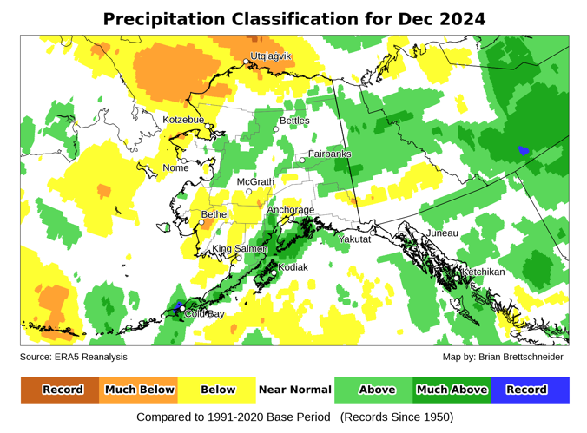
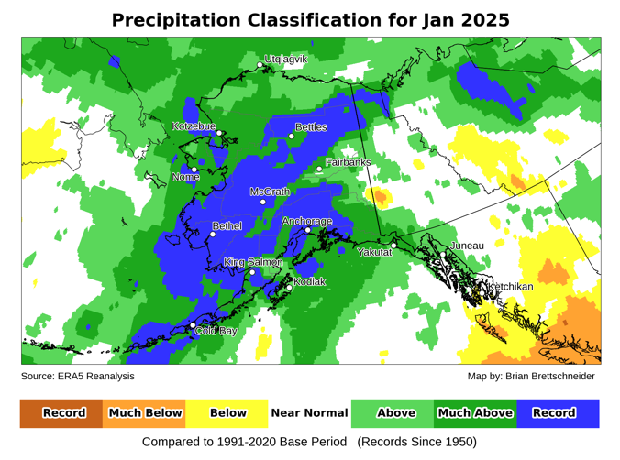
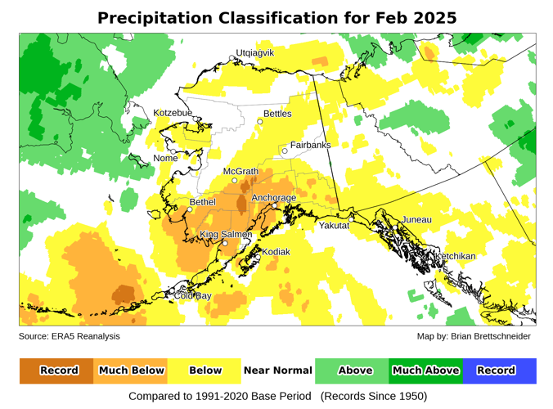
Winter 2024-25 precipitation
Data: ERA5 courtesy of EMCWF/Copernicus
1991-2020 Baseline
Notes:
AK Summer: 45% of Alaska land area temp above normal, first summer since 2014 with less than half of the state warmer than normal
YT Summer: 4th summer in a row 100% above normal
NWT Summer: 99% above normal but lowest since 2021
AK Summer: 83% of Alaska land area above normal precipitation. Highest since 1998

Slide 7
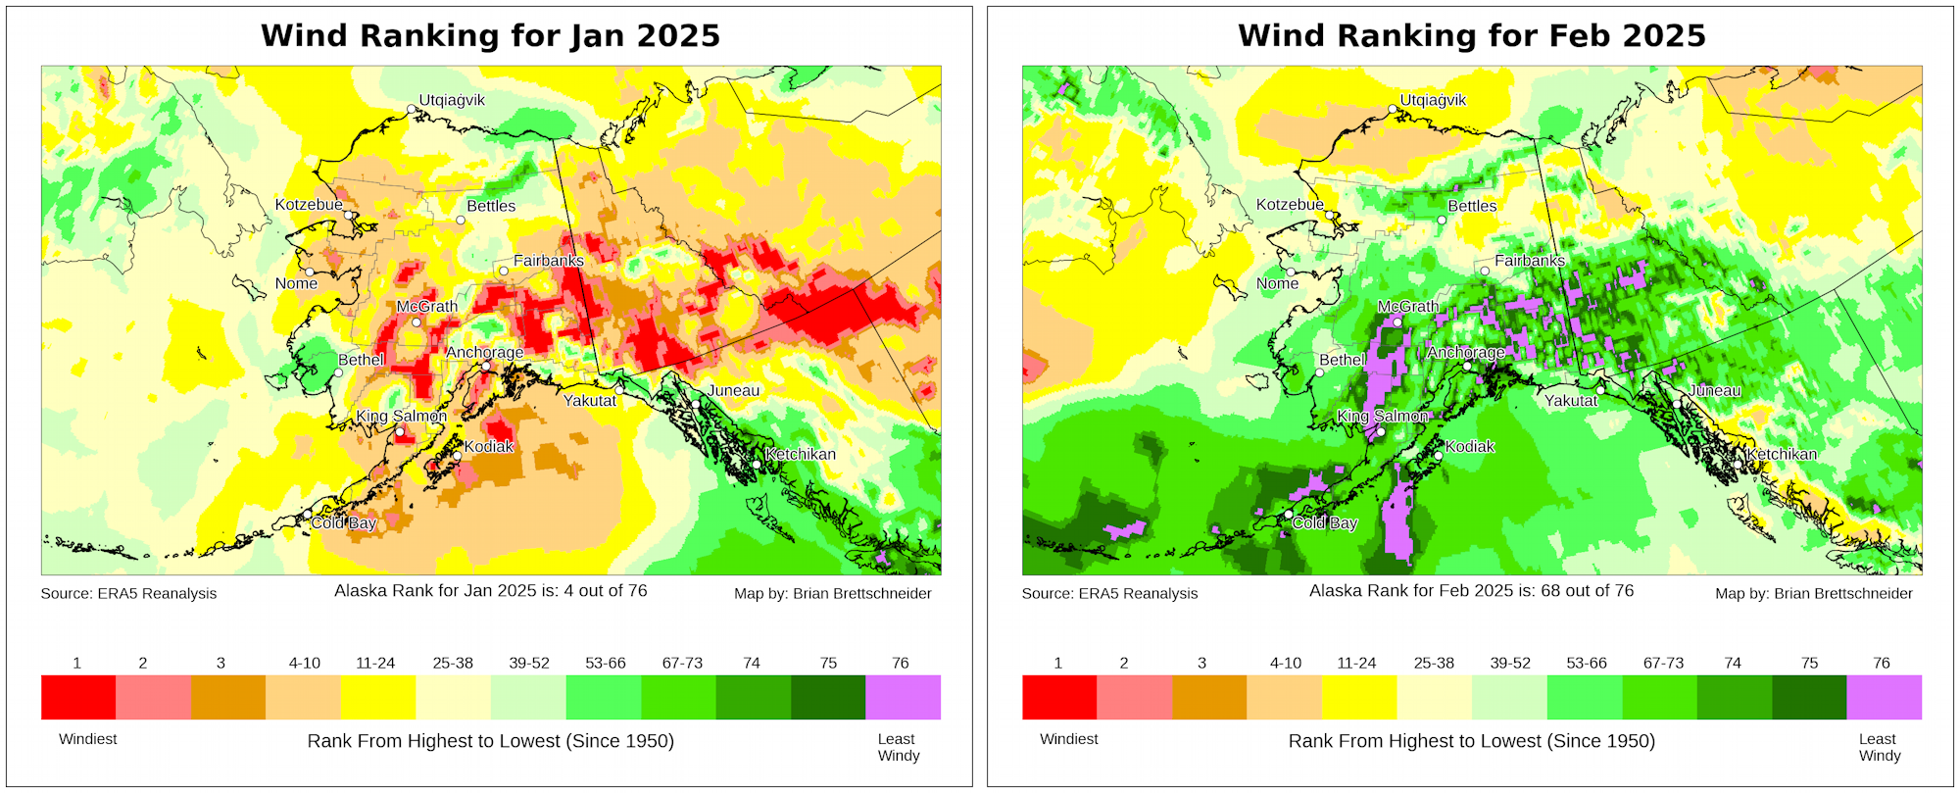
January-February 2025 winds
Data: ERA5 courtesy of EMCWF/Copernicus
1991-2020 Baseline
Notes:
AK Summer: 45% of Alaska land area temp above normal, first summer since 2014 with less than half of the state warmer than normal
YT Summer: 4th summer in a row 100% above normal
NWT Summer: 99% above normal but lowest since 2021
AK Summer: 83% of Alaska land area above normal precipitation. Highest since 1998

Slide 8
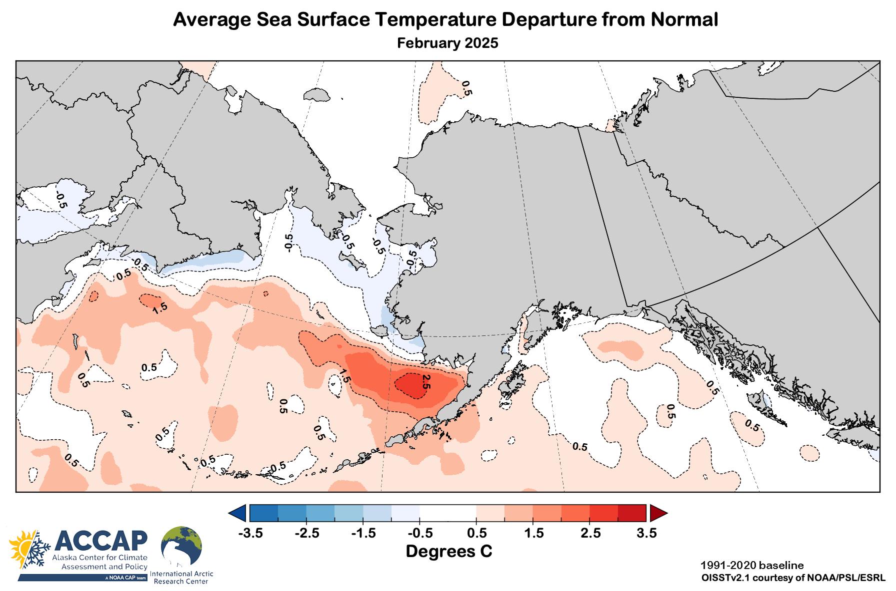
February 2025 sea surface temperatures

Slide 9
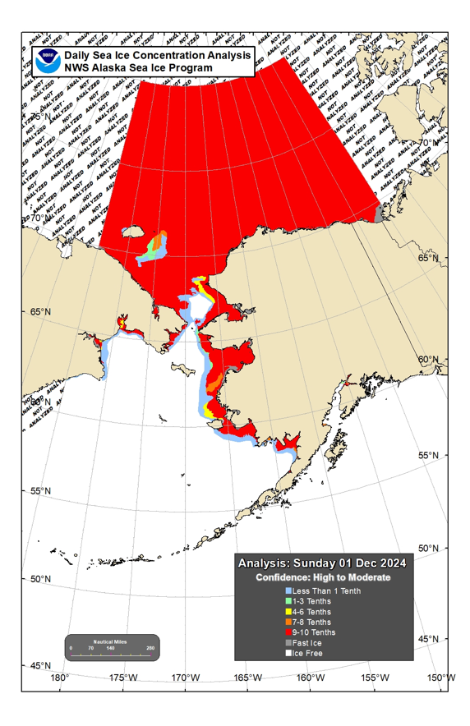
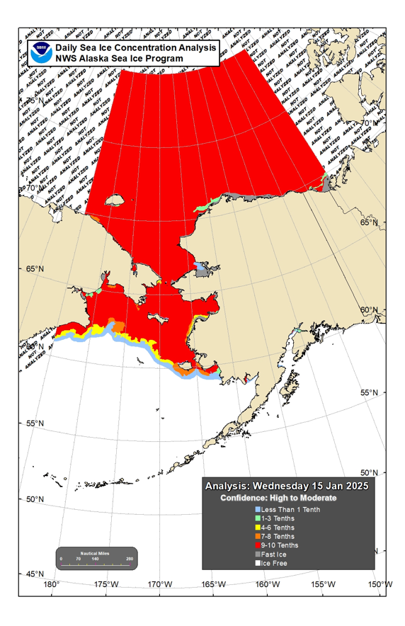
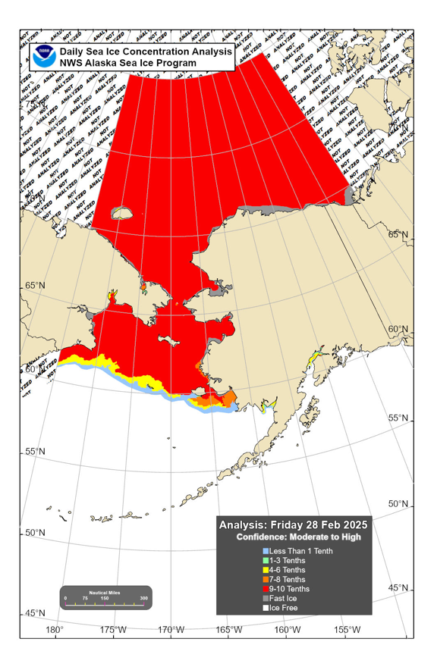
Sea ice extent: winter 2024-25
December 1
January 15
February 28

Slide 10
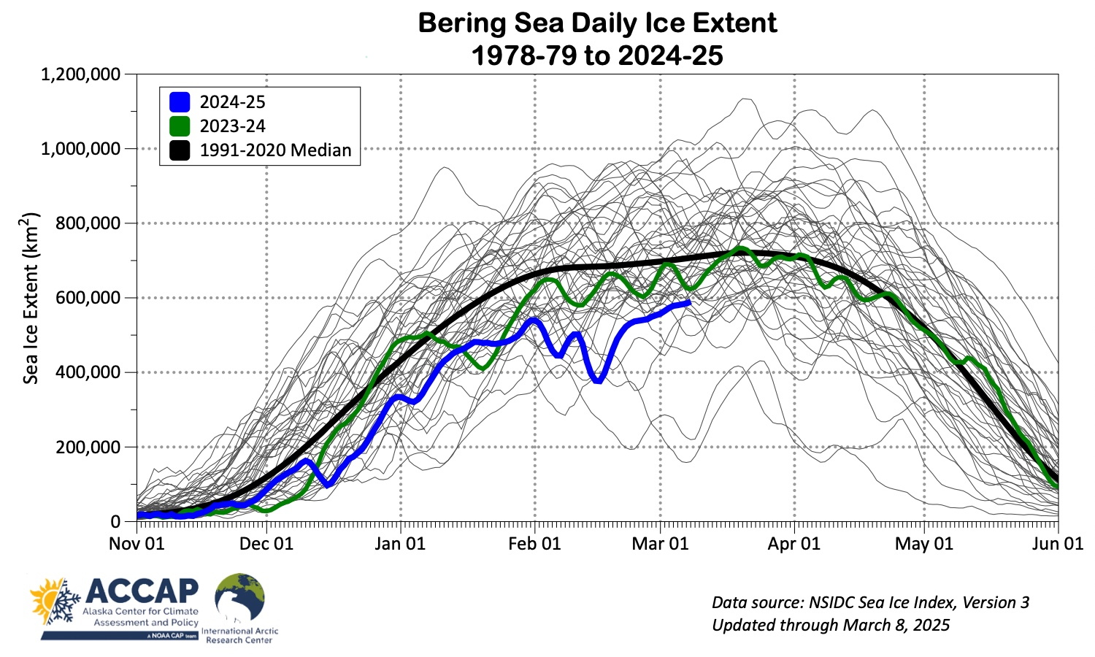
Bering Sea ice extent

Slide 11


Spring 2025 Outlooks
Arctic Sea Ice Experimental Outlook
Spring Sea surface temperatures
Spring temperature and precipitation

Slide 12
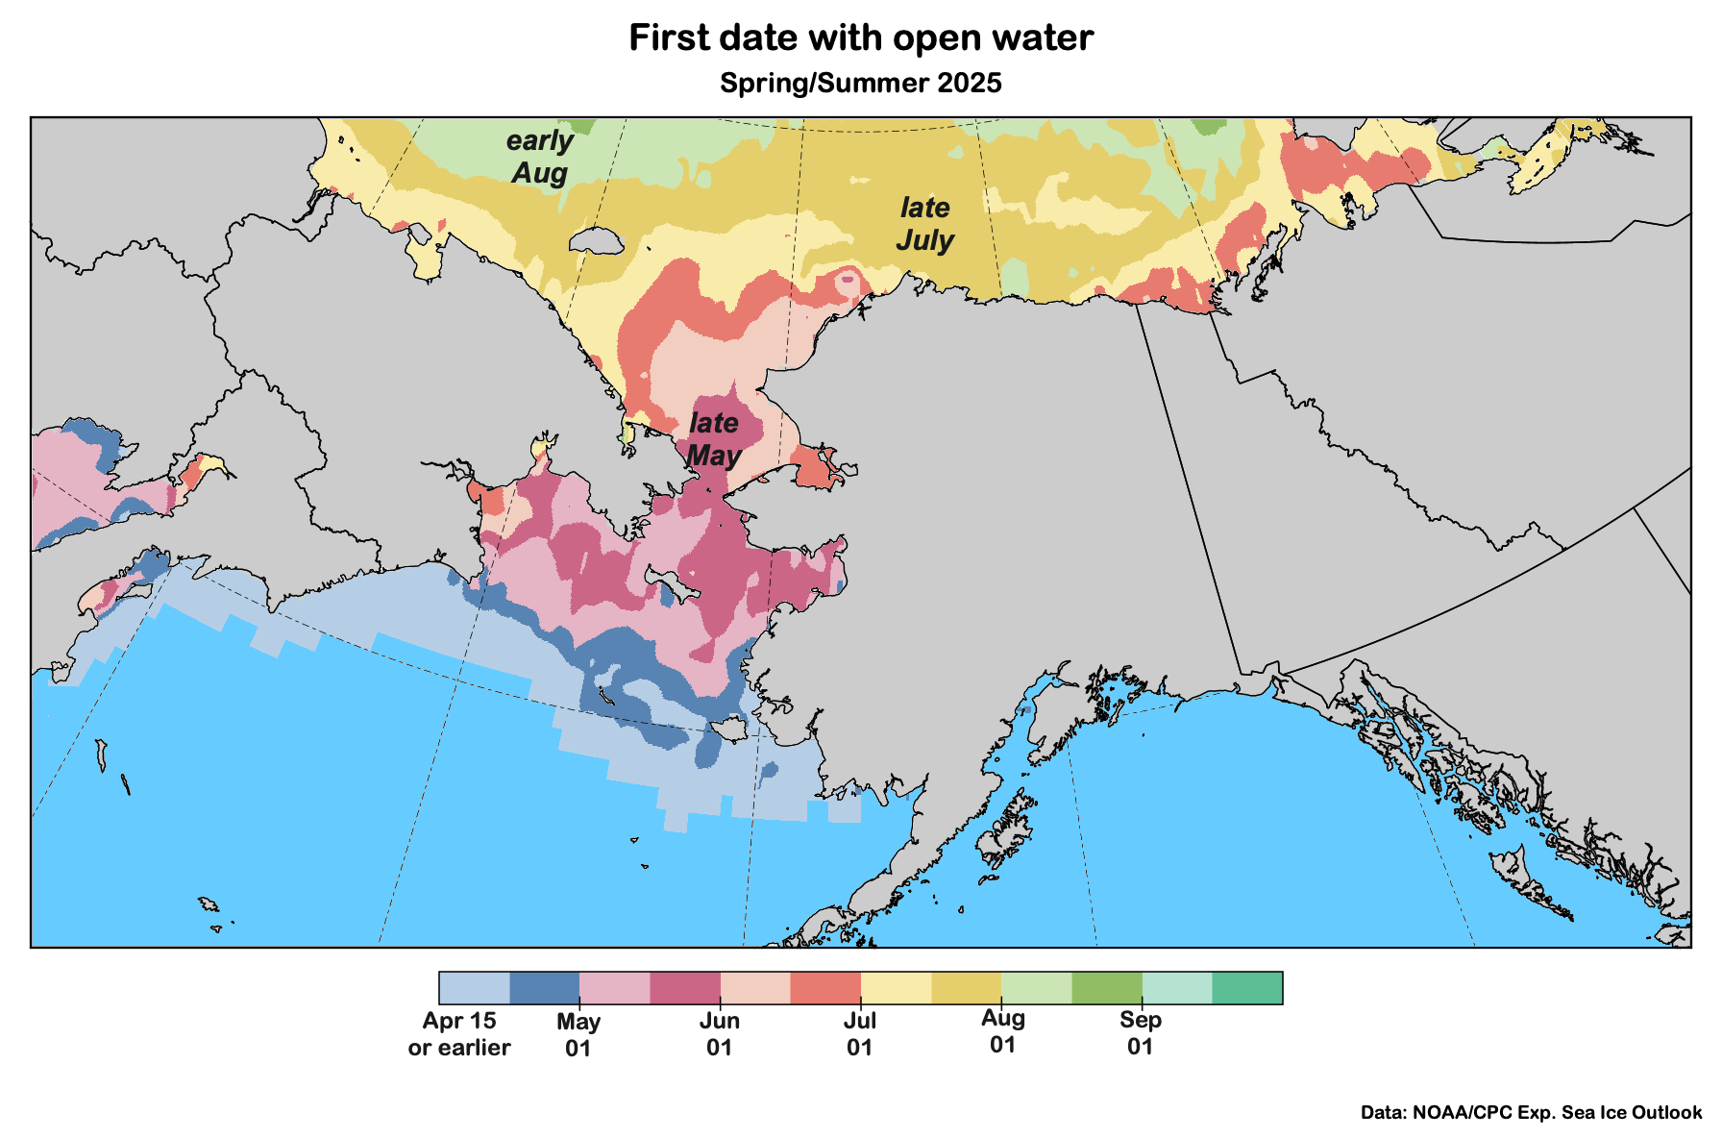
Sea ice outlook: Spring/Summer 2025
Data: NOAA/Climate Prediction Center Exp. Sea Ice Outlook
Outlook produced from late February 2025 data

Slide 13
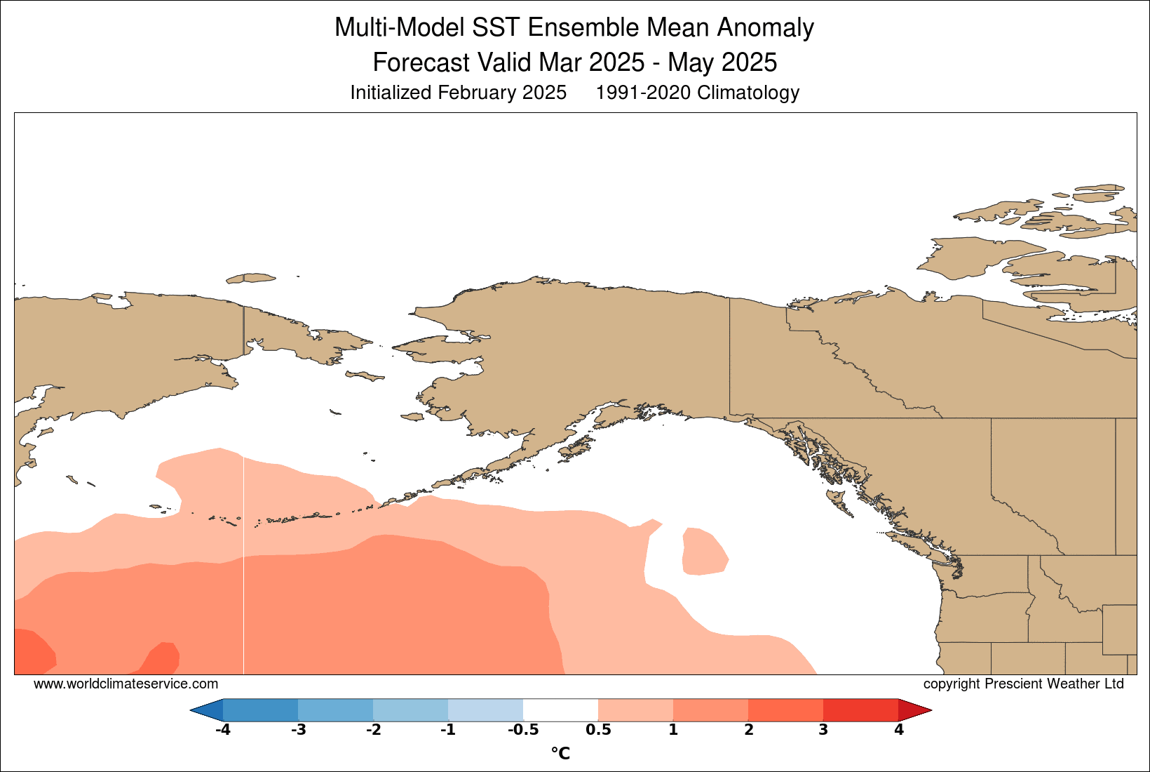
Sea surface temperature: Spring 2025
Graphic and outlook courtesy World Climate Service

Slide 14
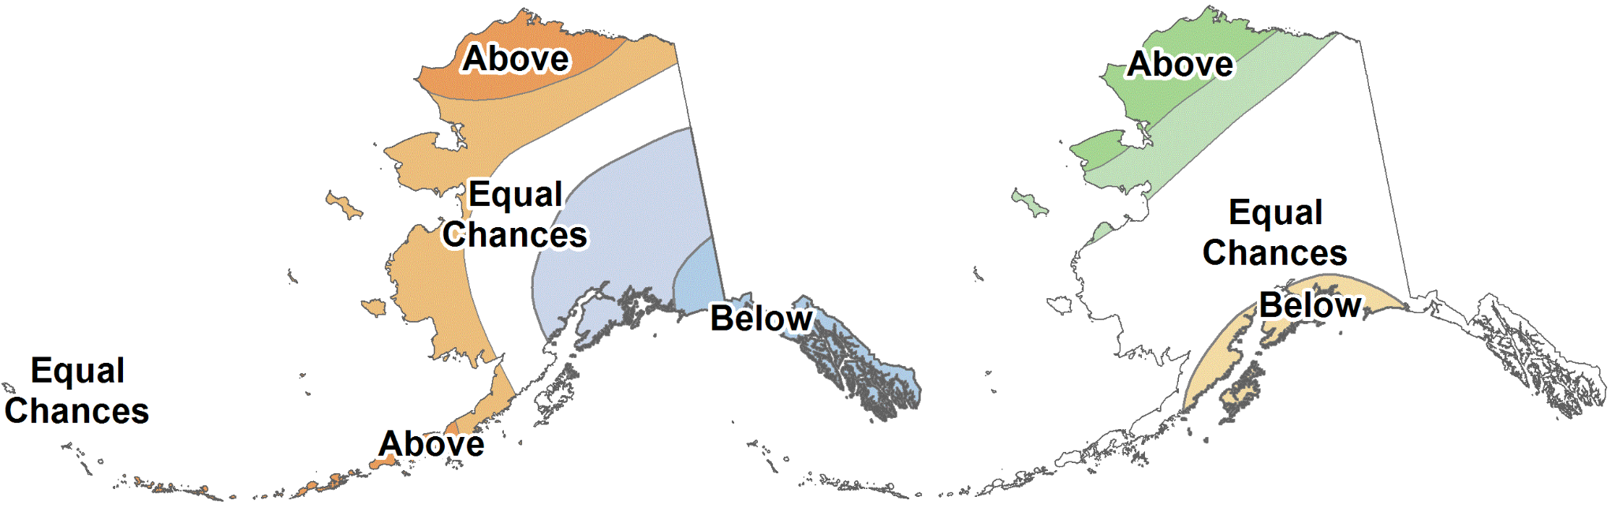
Spring 2025
NOAA Climate Prediction Center outlooks
Average Temperature
Total Precipitation
March through May 2025

Slide 15
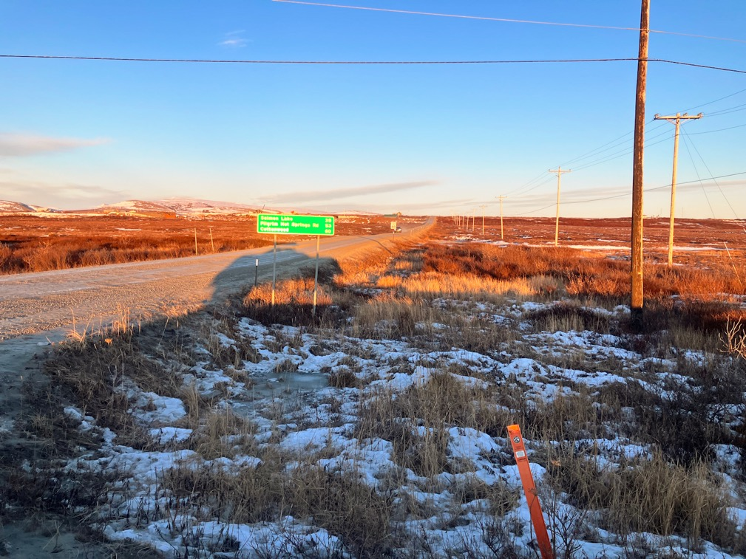

Thanks very much
Questions?
Nome tundra
January 3, 2025
Photo credit: G. Sheffield

