Slide 1
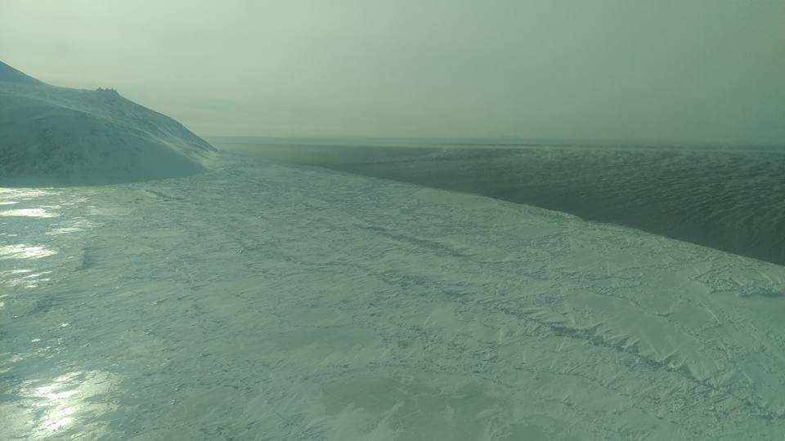
March 25, 2016

Slide 2
March 15, 2017

Slide 3
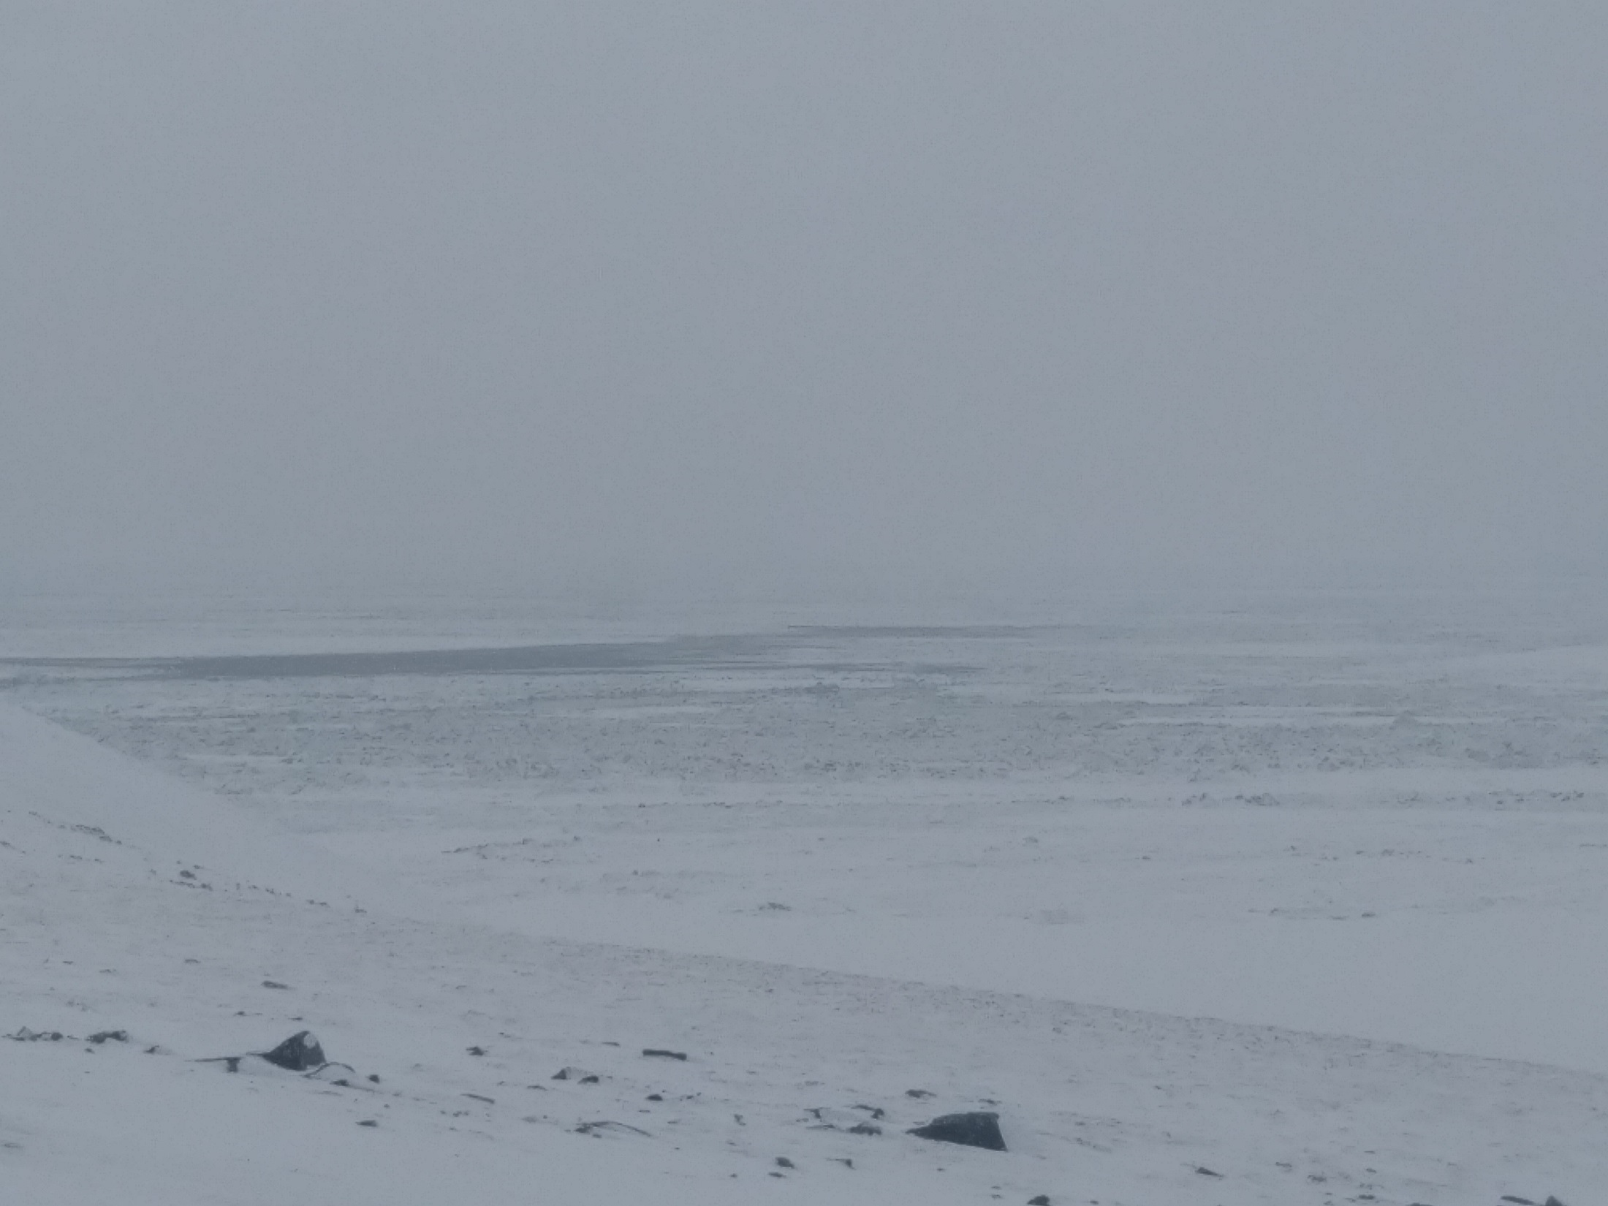
March 23, 2017

Slide 4
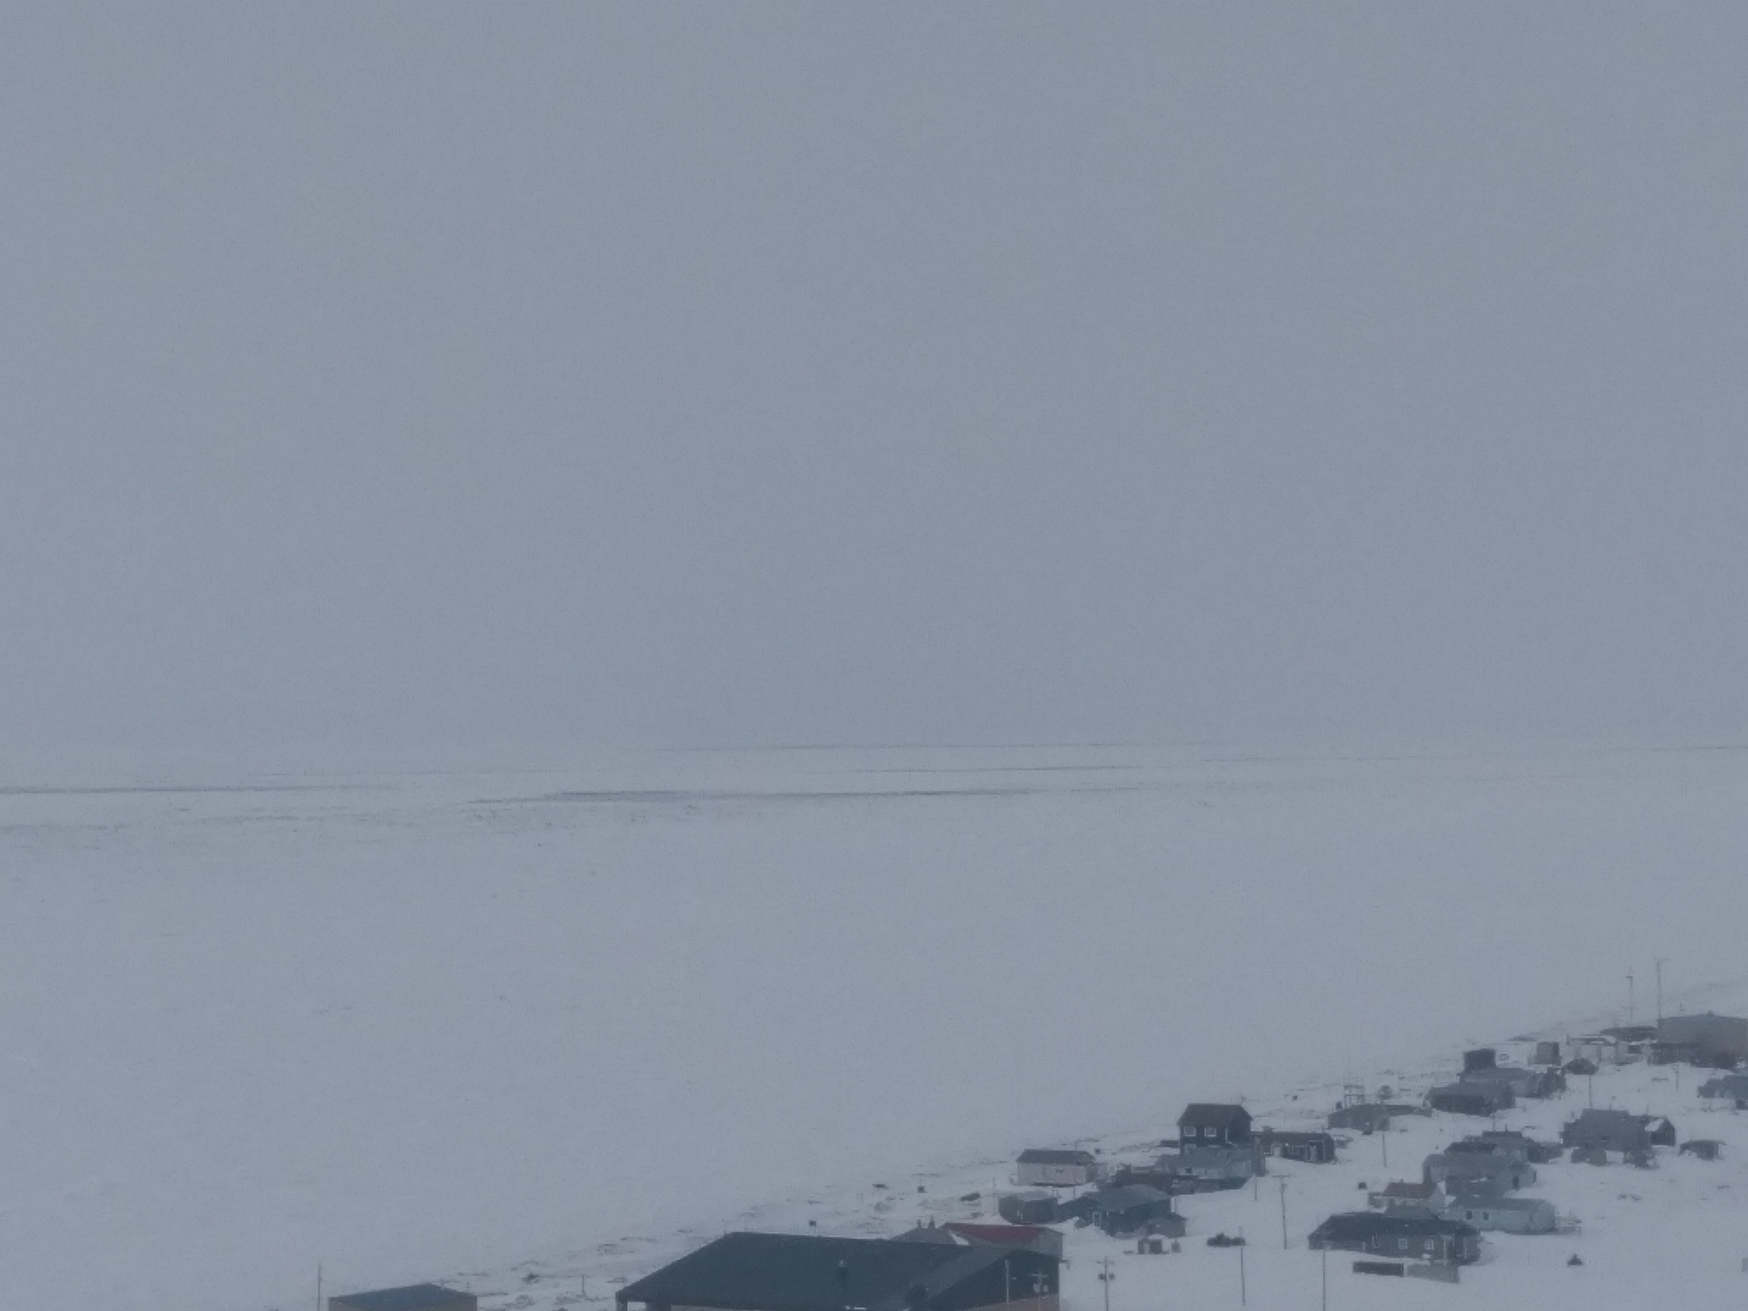
March 23, 2017

Slide 5
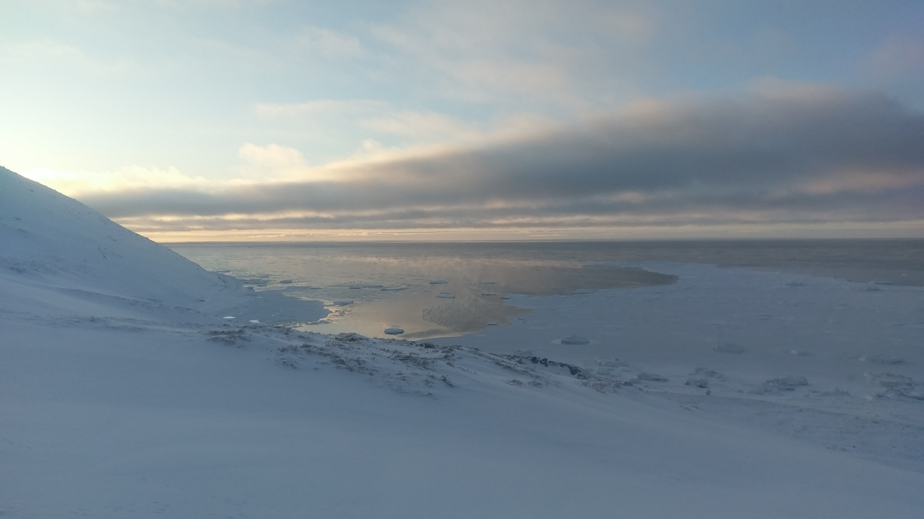
January 23, 2018

Slide 6
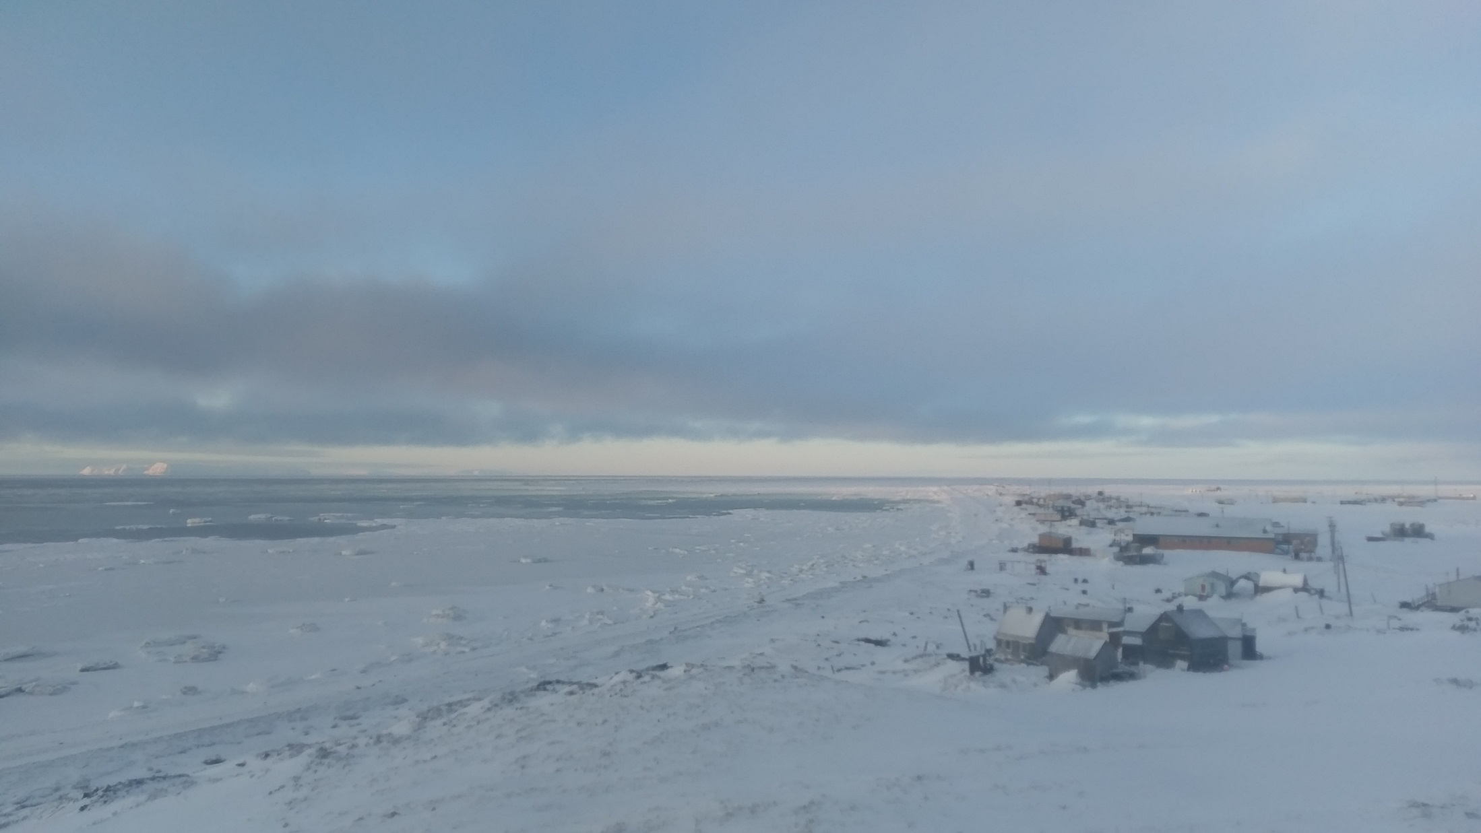
January 23, 2018

